Slide 1
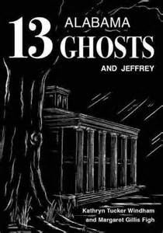
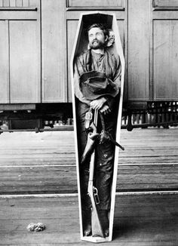
ALABAMA
Ghosts & Outlaws
Resources

Slide 2
Alabama
Outlaw Links
Rube Burrow - Wikipedia
Alabama's ties to the Lincoln assassination: 3 strange tales
5 notorious outlaws from Alabama's Wild West days
Stephen S. Renfroe - Sumter County, Alabama's Outlaw Sheriff
James Copeland - Wikipedia
The "Burrow Gang": Alabama Outlaws

Slide 3
Alabama
Ghost & Haunting Links
5 Tall Tales From Alabama Folklore
7 most terrifying places in Alabama
13 Alabama Ghosts and Jeffrey
Alabama Ghost Sightings
Haunted Houses of Alabama
Most Haunted Places in Alabama

Slide 4
Alabama
Books
Alabama Scoundrels: Outlaws, Pirates, Bandits, & Bushwhackers by Kazek & Elrick
Jeffery’s Latest 13: More Alabama Ghosts

