Slide 1
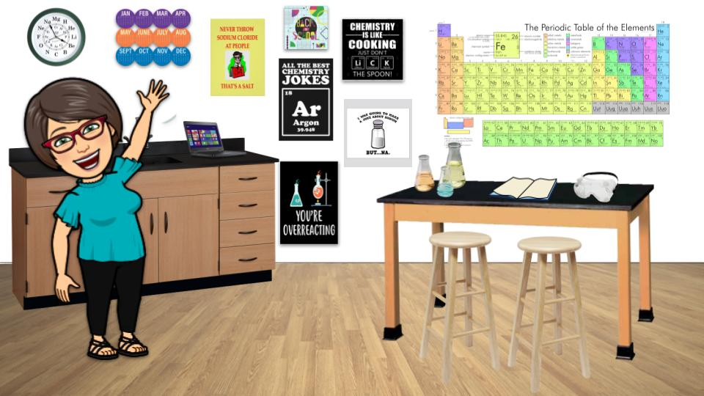
Meet Mrs. Martz
Notes:
Welcome! I am Mrs. Martz and I am so excited that you are going to be in my class this year. We are all going to be learning as we go throughout the year and it is going to be a great journey for us all!

Slide 2
Mrs. Martz
I am so excited to be at Tuscaloosa County High School. I am originally from Northport and was fortunate to attend TCHS myself (class of 1994).
Notes:
I am blessed to be able to teach at my Alma Mater. I graduated from TCHS in 1994.

Slide 3
I attended the University of Alabama to receive my Undergraduate and Graduate Degrees.
Notes:
After graduation, I went on to the University of Alabama where I earned a Bachelor’s degree in Biology and a Master’s degree in Secondary Science Education.

Slide 4
I have a wonderful husband, John and two precious girls, Hannah and Kayla.
Notes:
While working on my Master’s degree, I met and married my husband John. He is not only my husband, but my best friend. We have been married for 22 years. God has blessed us with 2 beautiful and smart daughters, Hannah and Kayla. Hannah is starting her Senior year at TCHS and Kayla is starting 7th grade at Echols Middle School.

Slide 5
We have a dog (who thinks he is a human just like us) named Teddy.
Notes:
We also have a dog named Teddy. He thinks he is a human like us, and most importantly he thinks that he runs the house and loves bread.

Slide 6
I taught 8th grade Physical Science for 14 years (7 years at Berry Middle School in Hoover and 7 years at Collins-Riverside Middle School) and I am now beginning my seventh year teaching high school at TCHS.
Notes:
After receiving my Master’s degree, I began teaching at Berry Middle School in Hoover. I taught there for 7 years before moving back to Tuscaloosa to be closer to my family. Once back home, I taught at Collins Riverside Middle School for 7 years before coming to TCHS. I am now on my 8th year at TCHS and I couldn’t be happier.

Slide 7
We attend Carrolls Creek Baptist Church where my husband is the Children's Minister and I get to work with the children.
Notes:
We are members of Carrolls Creek Baptist Church. My husband is the Children’s Minister and I help him with the Preschool classes. Hannah and Kayla are part of the youth ministry and love it!

Slide 8
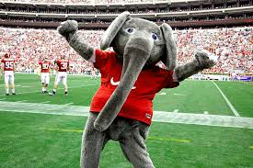
Notes:
Please know that I am always here for both you and your parents if you ever need anything. I look forward to getting to know you and to having a fantastic school year! Go Wildcats and Roll Tide!

