Slide 1
U.S. Citizenship

Slide 2
Concept 1: United States Geography

Slide 3
States
The U.S. is made up of 50 states
48 contiguous states (sharing a common border; touching)
Alaska and Hawaii
All states have a 2 letter postal abbreviation.
The U.S. also has 5 territories all across the world
Puerto Rico, Guam, U.S. Virgin Islands, American Samoa, Northern Mariana Islands
Each state and territory has their own capital city

Slide 4
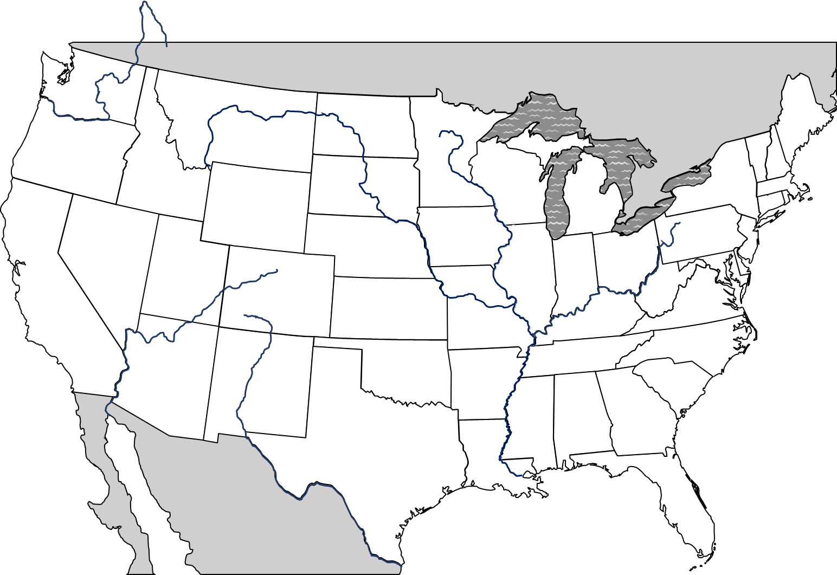
Waterways and Neighbors
The continental U.S. touches the Atlantic Ocean, Pacific Ocean, and the Gulf of Mexico
To the north there are the 5 Great Lakes
Lake Huron, Lake Ontario, Lake Michigan, Lake Erie, Lake Superior
The longest river in the U.S. is the Missouri River
The second longest river is the Mississippi River
Canada borders the U.S. to the north and Mexico shares a border with the U.S. in the south
CANADA
WASHINGTON
Great
Lakes
MONTANA
Columbia
NORTH
DAKOTA
MINNESOTA
MAINE
OREGON
MICHIGAN
VT
IDAHO
WISCONSIN
NEW
NH
SOUTH
DAKOTA
YORK
WYOMING
Missouri
Mississippi
MICHIGAN
MASS
RHODE
ISLAND
Rocky Mountains
IOWA
PENNSYLVANIA
CONNECTICUT
NEBRASKA
NEW JERSEY
Appalachian Mountains
NEVADA
ILLINOIS
INDIANA
OHIO
DELAWARE
UTAH
WEST
Colorado
COLORADO
Ohio
VIRGINIA
MARYLAND
KANSAS
VIRGINIA
Washington, D.C.
CALIFORNIA
MISSOURI
KENTUCKY
Pacific
Ocean
Rio Grande
TENNESSEE
NORTH CAROLINA
Atlantic
Ocean
ARIZONA
OKLAHOMA
SOUTH
NEW
MEXICO
ARKANSAS
CAROLINA
ALABAMA
MISSISSIPPI
GEORGIA
TEXAS
LOUISIANA
MEXICO
Gulf of
Mexico
FLORIDA

Slide 5
America’s Special Places
The Capital of the U.S. is located in Washington D.C.
Statue of Liberty is located in New York City
The United States has numerous National Parks across the country that are protected wildlife areas
Ex: Yellowstone, Yosemite, etc.

Slide 6
Concept 2: U.S. Citizens

Slide 7
Why Civics?
Civics is the study of citizenship and government
Citizens have rights and responsibilities
One responsibility of being a citizen in the U.S. is being a productive and active member of society
In order to become a good citizen, you need to understand our government and economic system.
Notes:
Need training to become a good musician, likewise you need training to become a good citizen.

Slide 8
American Values
America is founded on equality, liberty, and justice for all.
Equality
Ideally means that all people are equal under the law.
No citizen has the right to act as if their liberties are more important than another person.
Liberty
We have the right to practice the religion we choose, start a business, choose where you live, etc.
Justice
Your rights cannot be taken away from you as long as you follow the law

Slide 9
Qualities of a Good Citizen
We cannot have a country “by the people” unless the people participate in the government.
Voters elect candidates who they fell represent their interest
Elected officials act in ways that they think will make their voters happy.
If voters are unhappy with elected officials they will not re-elect them at the next election
Expressing your opinion to government officials is also a responsibility of citizens
If officials do not know your opinion they cannot act on it

Slide 10
Americans are from Everywhere
Immigrants are people who come to the U.S. from other countries.
U.S. is like a melting pot but also a salad bowl
Earliest Americans settled here between 12,000 and 40,000 years ago
Christopher Columbus sailed to the Caribbean in 1492
Europe soon began sending settlers to settle in North America
Spain – Caribbean, Mexico, Central & South America, FL, TX, CA, and Southwest U.S.
United Kingdom – 13 colonies
Germany – PA
France – NY, MA, SC
Africans also came to the U.S. but unlike other settlers most were captured and brought to the U.S. against their will

Slide 11
Immigration Policy
The U.S.’ freedom and abundant land attracted immigrants from all over.
In the 1880s, the U.S. congress passed laws limiting immigration
In the 1920s, laws were passed that established a quota of immigrants from certain regions.
Today, the Immigration Act of 1990 sets the total annual quota of immigrants at 675,000.

Slide 12
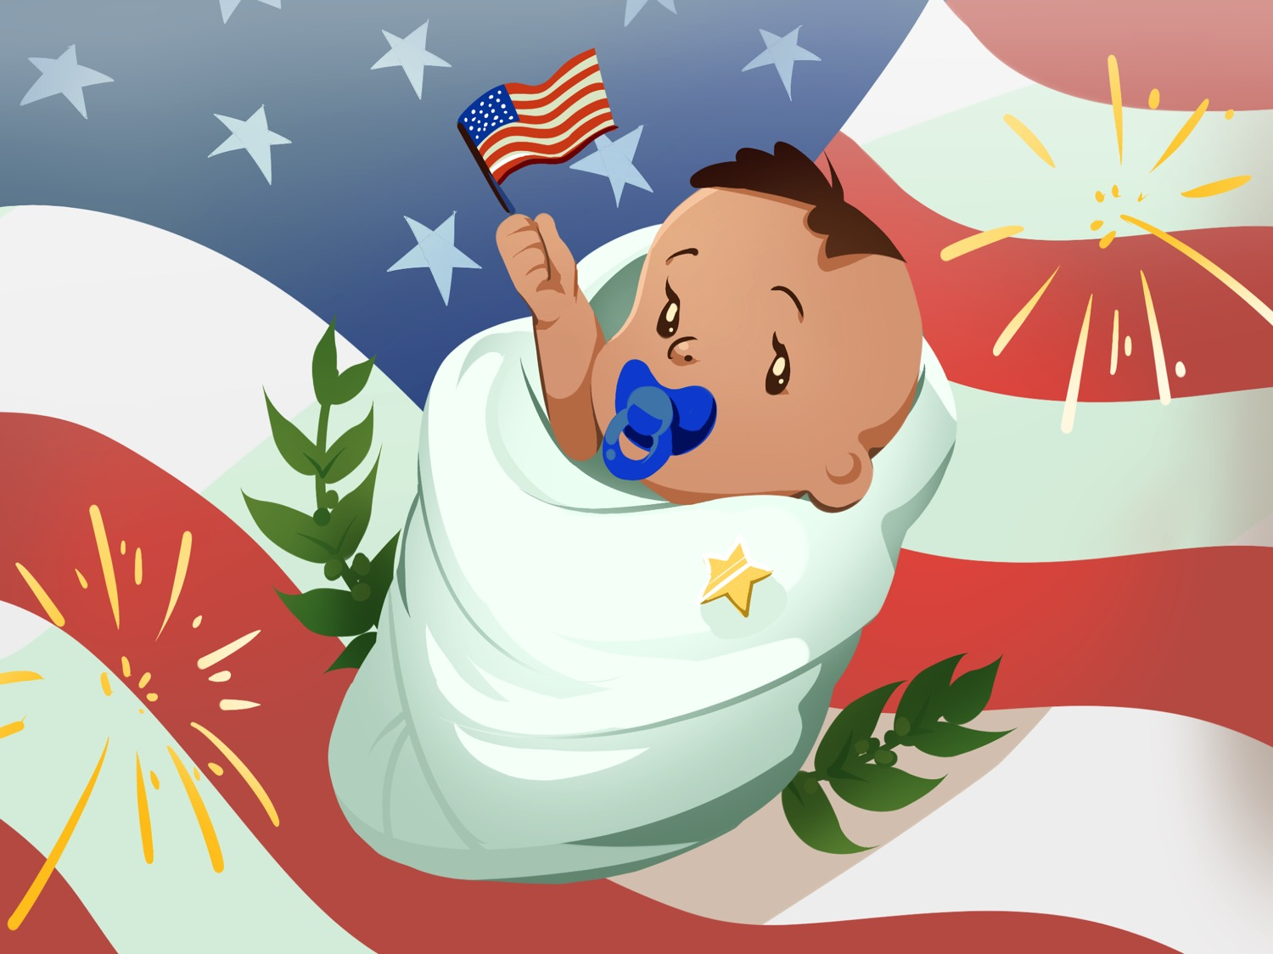
Becoming a U.S. Citizen
There are different ways to become a U.S. citizen
Citizenship by birth
You were born in any U.S. state or territory
If one or both of your parents was a U.S. citizen then you are too.
Citizenship by Naturalization
The legal process by which an alien can become a citizen.
When a parent is naturalized, their children automatically become citizens

Slide 13
Types of Immigrants
Aliens
Permanent resident of the U.S. that claims citizenship of another country.
Unlike U.S. citizens, aliens must carry an identification card at all times.
Illegal Immigrants
Some people come to this country illegally looking for better education, jobs, healthcare, etc.
Life for illegal immigrants is hard and they often work for low wages under poor conditions.
Despite attempts to discourage illegal immigration, the flow of illegal immigrants is still high.
Refugees
Today’s immigration quotas do not include refugees, people who are trying to escape dangers in their home countries

Slide 14
Concept 3: Civic Duties

Slide 15
Rights and Responsibilities
As a U.S. citizen, you have certain rights and responsibilities.
Rights
Freedom to express yourself
Freedom to worship as you wish
Right to a prompt, fair trial by jury
Right to vote in elections for public officials
Right to run for elected office
Freedom to pursue “life, liberty, and the pursuit of happiness”

Slide 16
Responsibilities
Support and defend the Constitution
Stay informed of the issues affecting your community
Participate in the democratic process
Respect and obey federal, state, and local laws
Respect the rights, beliefs, and opinions of others
Pay income taxes honestly, and on time, to federal, state, and local authorities
Serve on a jury when called upon
Defend the country if the need should arise.

Slide 17
What does all this mean?
This list is given to immigrants who are applying for citizenship to the United states.
There are many rights that are promised to us as citizens that are laid out in the Constitution
However, citizens must also fulfill their responsibilities to make sure our government represents the people and runs.

Slide 18
Concept 4: The U.S. Today

Slide 19
The Census
An official periodic counting of a population
U.S. conducts a census every 10 years
Census information is mostly used to find out how many people live in each state
Determines representation in Congress
The census also collect information on demographics
Census might provide information on ethnic background, number of children, number of pets, etc.

Slide 20
Population Growth
The U.S. population is estimated to be at 327 million in 2018.
Countries grow through natural increase, by adding territory, or through immigration.
Natural increase happens when the birthrate out paces the death rate.
Adding territory is when a country annexes in new lands.
Immigration is when people move to a new country.

Slide 21
Population Changes
The American family and their way of life have changed throughout our history.
American households have changed in several ways
An increase in divorces has lead to one-parent households, many of them headed by women
Couples are having fewer children or are waiting to have children.
Some people do not marry
People are living longer
Women’s roles have also changed and more women are working outside the home
More women today graduate college than men

Slide 22
The American population is getting older
The 2000 census counted about 65,000 centenarians.
People live longer due to healthier lifestyles and better medical care.
This causes problems as there is a shrinking proportion of younger wage earners
Less people to support older Americans
Our population is also more diverse
The 2000 census had new categories for people to select
Reflects various ethnic groups

Slide 23
A Population on the Move
When America was founded we were a nation of mostly farmers
The rise of industry in the 1800s brought more people to the cities
Overcrowding in the late 1800s became a problem
The affordable automobile in the 1920s allowed Americans to move out of the cities and into suburbs.
Today more than 80% of Americans live in metropolitan areas, or regions made up of cities and their suburbs.

Slide 24
For most of American history, the largest population was in the Northeast and Midwest.
Starting in the 50s, people began moving to the warmer southern states
Known as the “sunbelt”
Because of this population shift, cities in the South and West are growing.
Las Vegas is the fastest growing city but New York is still the most populous.

