Slide 1
Course Procedures, Guidelines and Expectations

Slide 2
Be prepared and On time EVERYDAY
You are expected to be prepared and on time to class each day. This means having all of your materials and in your seat when the bell rings.

Slide 3
Be Respectful
We are going to be like a family this year in class. It is important that you respect yourself, your classmates, and your teacher. Speak kindly and be considerate.

Slide 4
Wear your mask if you prefer.
We have been told at this time that masks are optional. If this changes, you will be told.

Slide 5
Sanitize before you come into class.
You will need to use hand sanitizer before entering the room. You will use the hand sanitation areas in the hall.

Slide 6
DON'T be late to class.
You will receive a Tardy if you are late to class.
3 tardies will result in an office referral.
You may choose to work off one tardy if you prefer. See teacher for details.

Slide 7
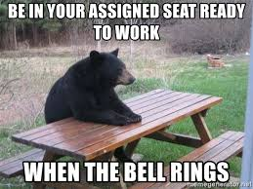
Sit in your assigned seat.
You will be given an assigned seat. You will be responsible for keeping the area around your desk neat and tidy.

Slide 8
NO Food or Drinks.
Food is not going to be allowed in the classroom. When packages and crumbs are not correctly picked up, it causes bugs.
We will only be allowed to have bottled water in class. No other beverages will be allowed.

Slide 9
NO Cell Phones in Class (except for instructional purposes)
Cell phone usage will not be allowed in the classroom.
The ONLY time that you may use a cell phone in class is if it is essential to our learning for the day and you must have permission from the teacher.

Slide 10
Complete your assignments on time
Complete all of your classwork and assignments on time. Failure to do so will result in late work and poor grades. Our content builds throughout the semester and not completing work could keep you from learning all that you need to learn.

Slide 11
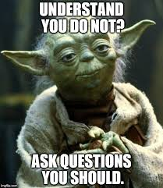
If you don't understand....ASK
I am here to help you learn. Please ask me questions if you don't understand something that we are doing in class.

Slide 12
BE HONEST
Be honest. Do your own work, not copy your friend's work. Any copying is considered cheating and both people involved will receive a zero for the assignment.

Slide 13
Grades
We will be using a point system for grades. You earn points for your assignments. The more points you earn, the better your overall grade will be.

Slide 14
Schoology
We will be using Schoology for online assignments. Schoology will have all of our assignments on it. If you are absent, you should check Schoology for any assignments.

Slide 15
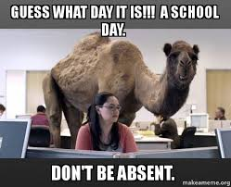
Absences
If you are absent, you must provide an excuse in order to be able to make up that work for a grade. If you are absent, you have two days to make up the work. All assignments will be on Schoology, so you will not have to wait until you get back to receive your make up work.

Slide 16
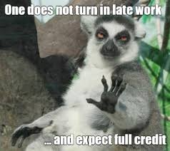
Late work
If your work is late, you can turn it in the next day for a letter grade off. After 3 days, the assignment will not be able to be turned in and you will receive a zero for that assignment.

Slide 17
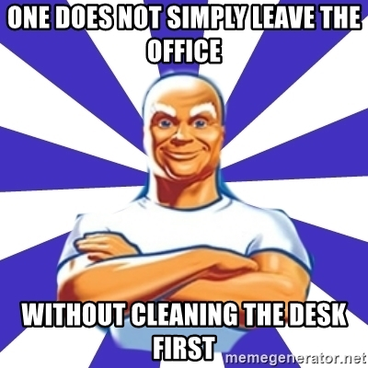
Cleaning your area before class ends
We will stop class a few minutes early each day to allow for us to clean your desks. You will receive a clean cloth, spray your desk with the provided cleaner and wipe down your desk. You will put your dirty cloth in the red bin.

