Slide 1
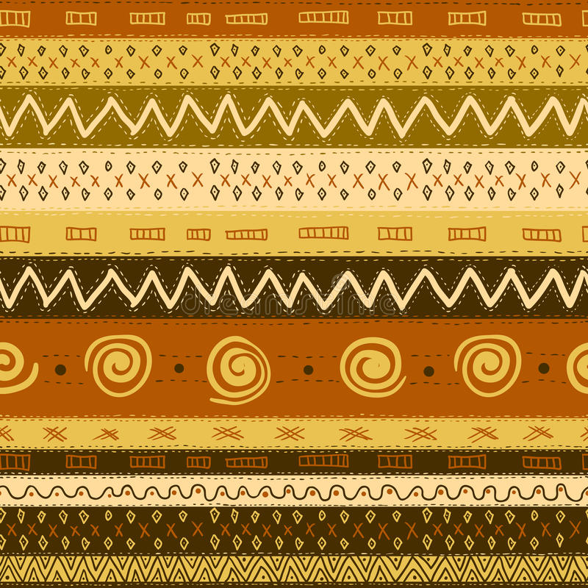
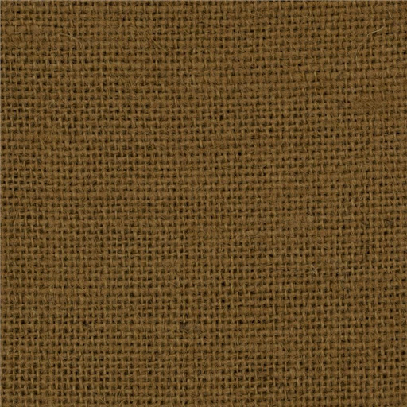
Background Information for Things Fall Apart

Slide 2
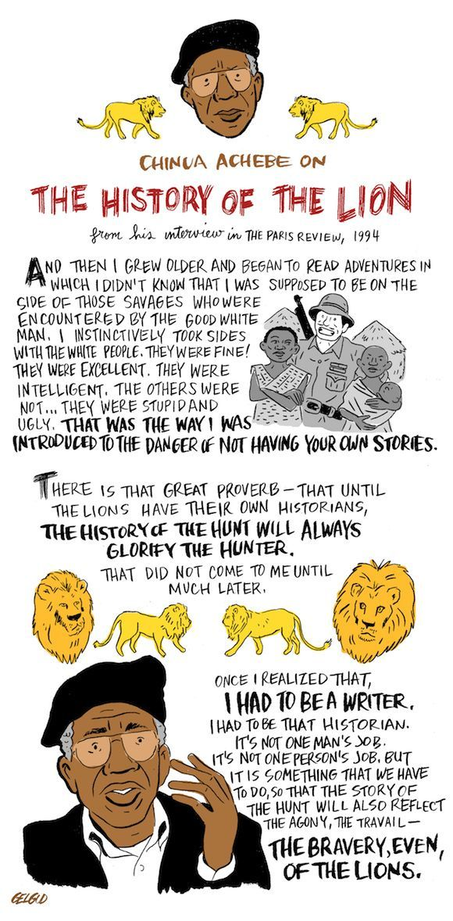

Slide 3
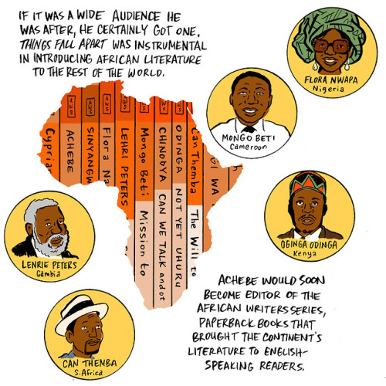
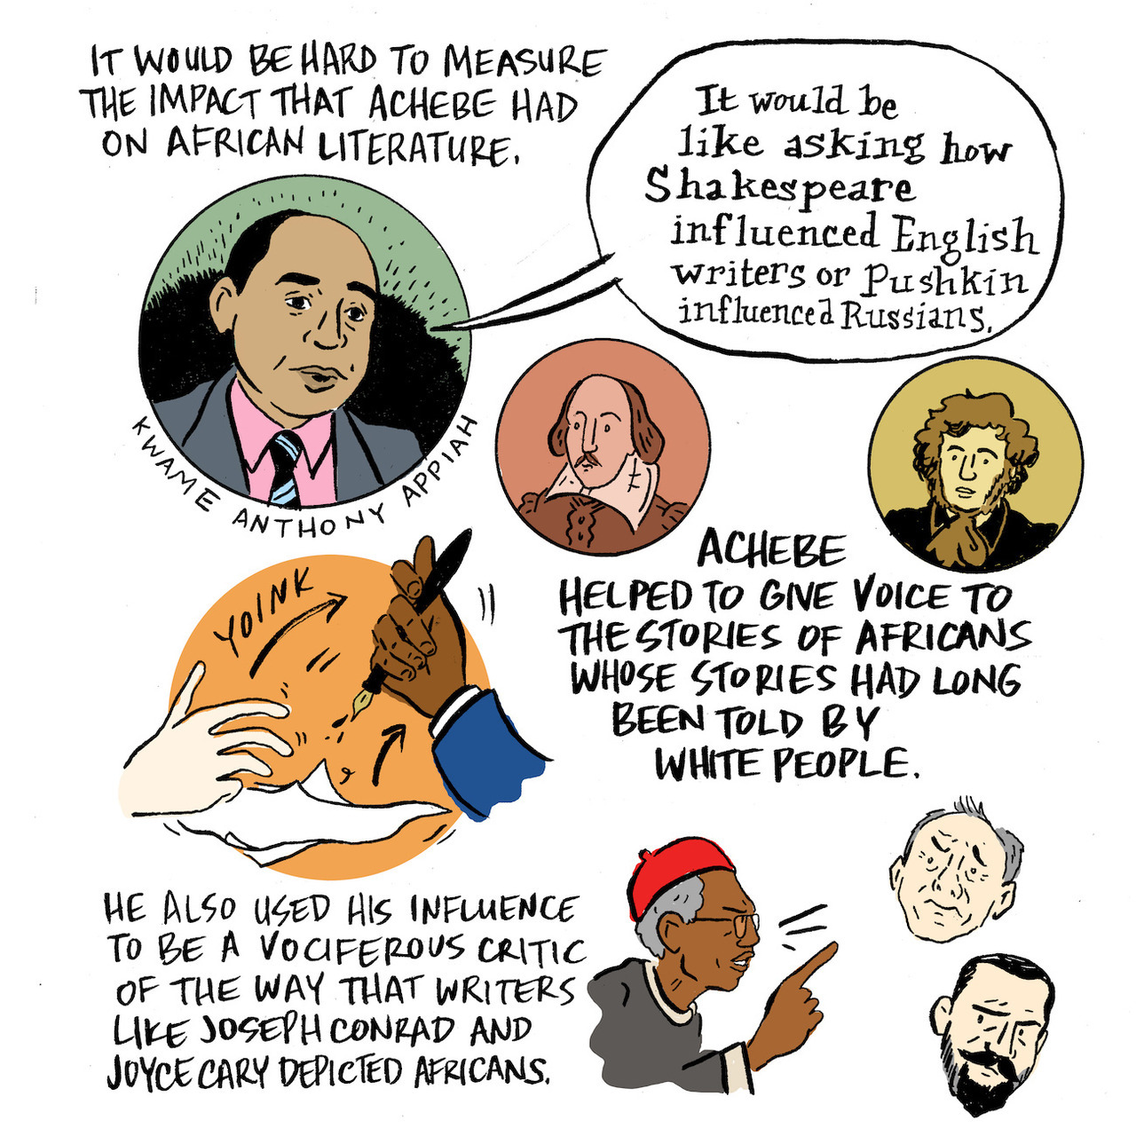
Source: Nathan Gelgud

Slide 4
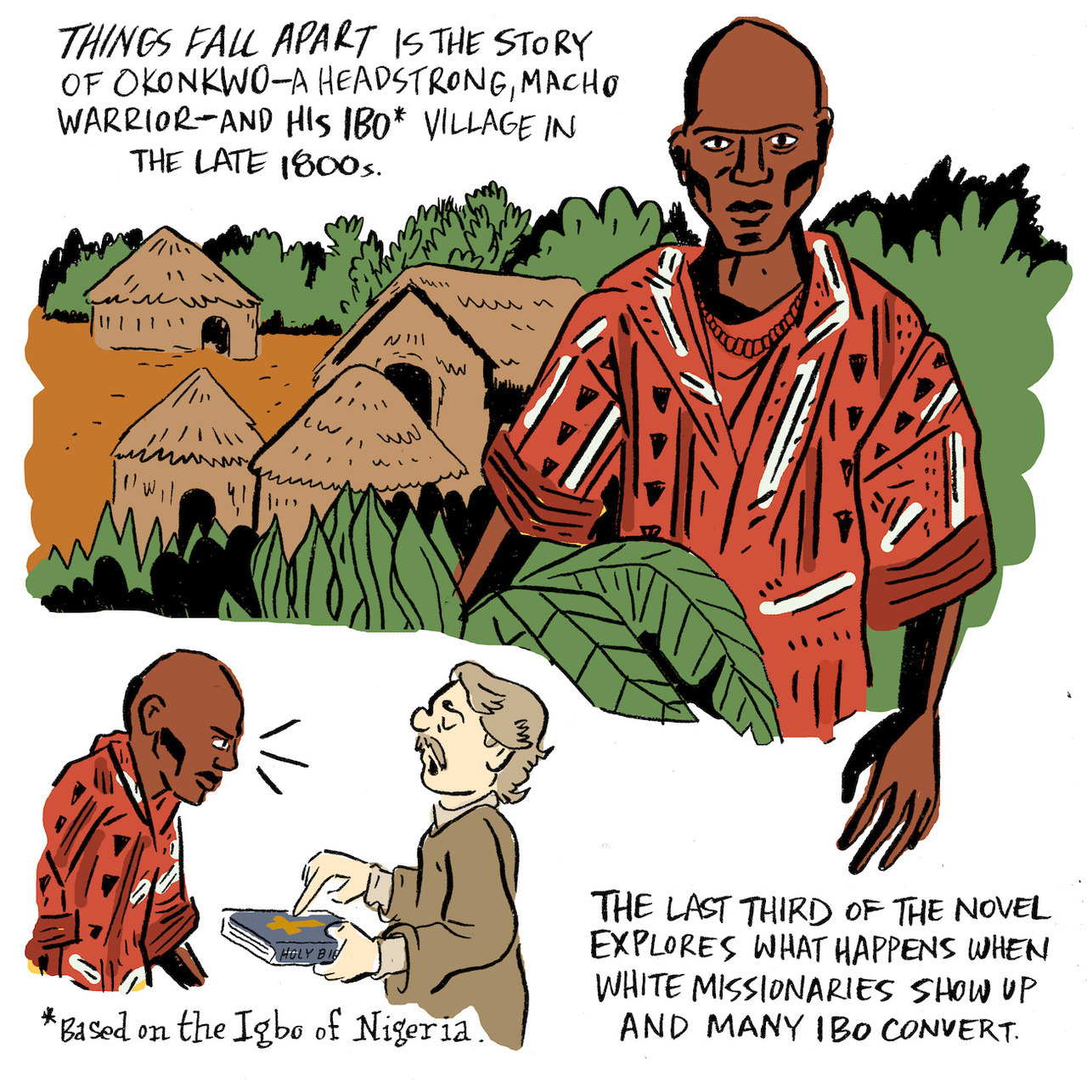
Source: Nathan Gelgud

Slide 5
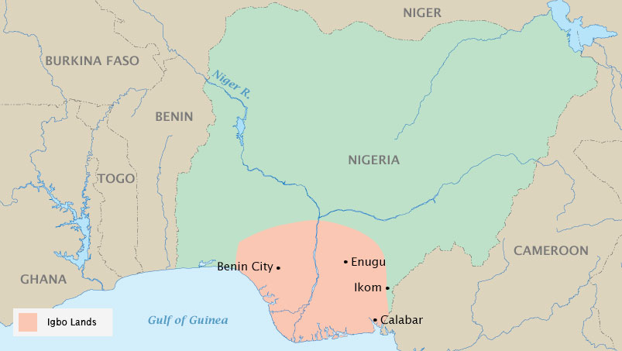
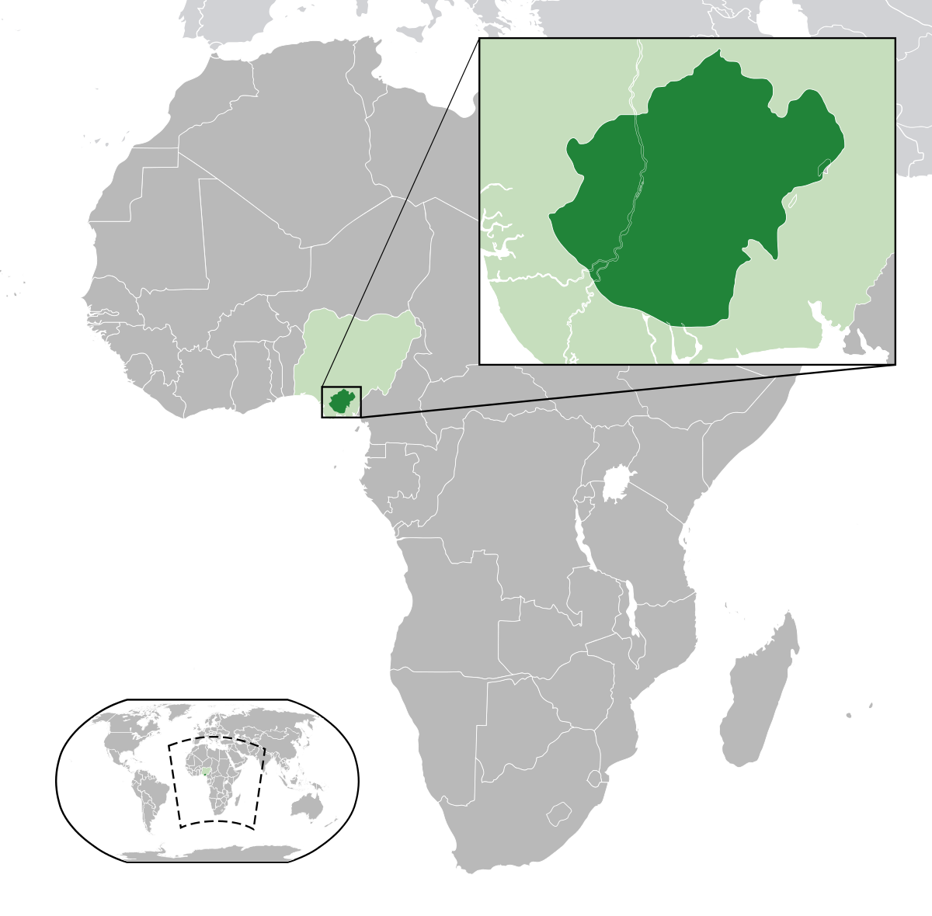
Location of the Igbo homeland (dark green) in Nigeria (green)
The pink area shows the Igbo lands, where the action of the novel takes place. © 2010 Map Resources, All rights reserved.
Every border you see on this map was drawn by a European power; Nigeria, which contains the Igbo lands of the novel, was created by the British. The map of Africa looked very different before the 1800s, before the arrival of colonizing European powers. The Igbo lands in the heartland of the Niger River valley (now southeastern Nigeria) were not expansive, but they created and nurtured a distinct culture for many centuries. Despite the artificial divisions and boundaries created by empire, the traditional cultures of Africa live on.

Slide 6
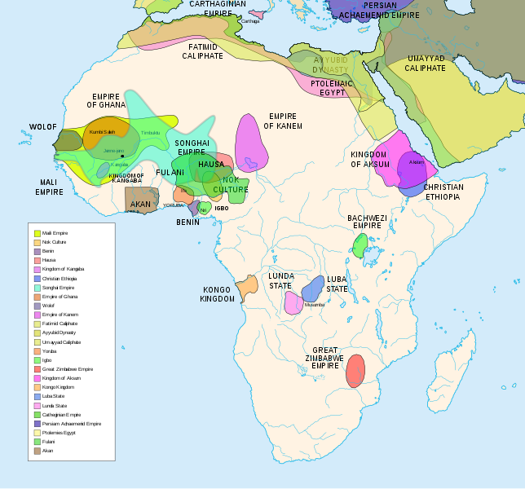
Pre-colonial African civilizations map Go to this link to zoom in for a closer look: https://commons.wikimedia.org/wiki/File:African-civilizations-map-pre-colonial.svg

Slide 7
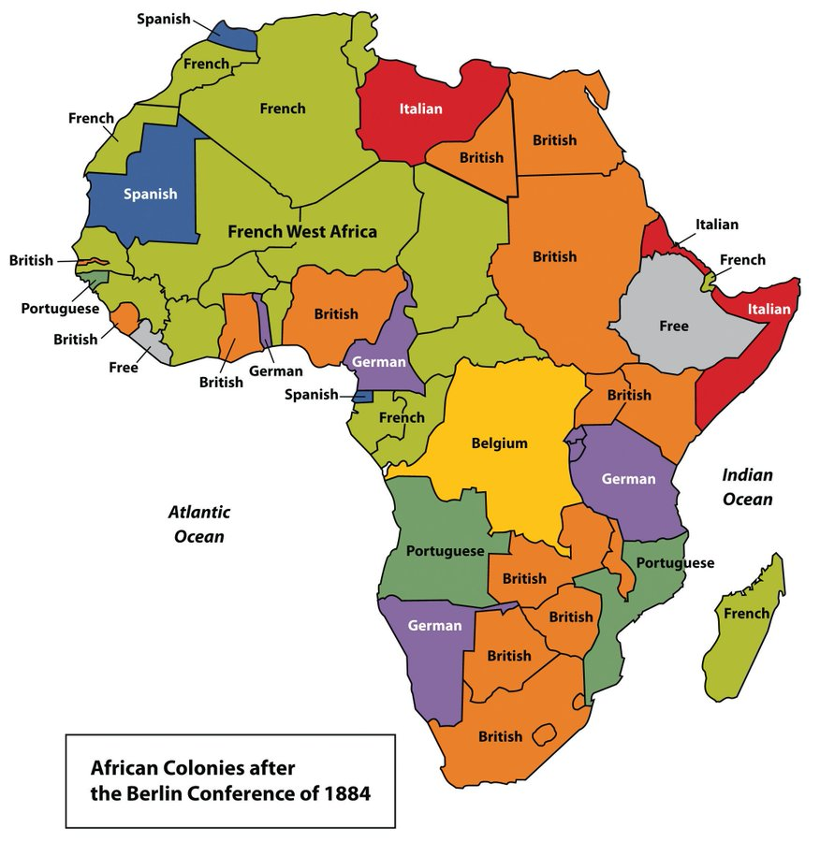
In addition to the map presented here, visit the link below to help you visualize how Africa changed once European countries began colonizing the country.
https://www.timemaps.com/history/africa-1914ad/

Slide 8
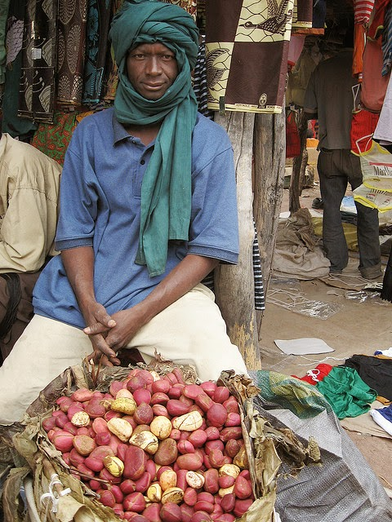
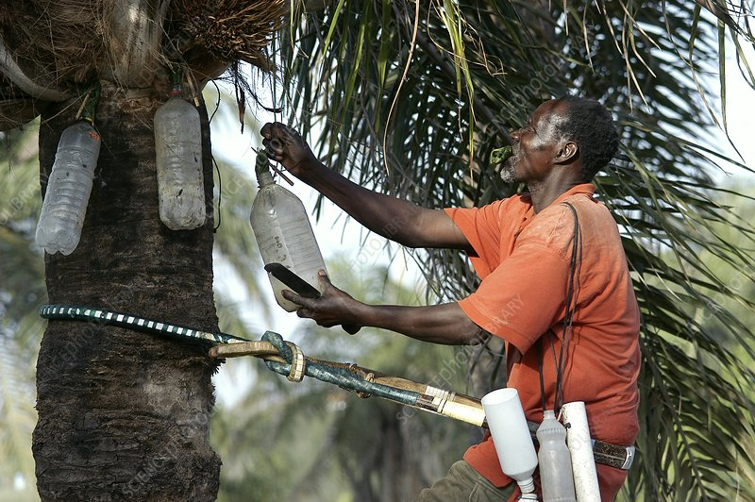
Igbo Food
As you read Things Fall Apart, you will learn that the Igbo people are farmers who depend on the crops they grow. Many of their foods are not only used for sustenance but also for religious ceremonies. Some of the foods will be familiar to you, but you may not have heard of others. Follow the links below to learn about two foods that are highly symbolic within the Igbo community.
Palm Wine
Kola Nut
https://www.chi-ism.org/iwa-oji---breaking-the-kola-nut
https://www.youtube.com/watch?v=7zj55v_KtRM
https://www.atlasobscura.com/foods/palm-wine

