Slide 1
Unit 4 Egypt and kush

Slide 2
Section 1
Geography and Ancient Egypt

Slide 3
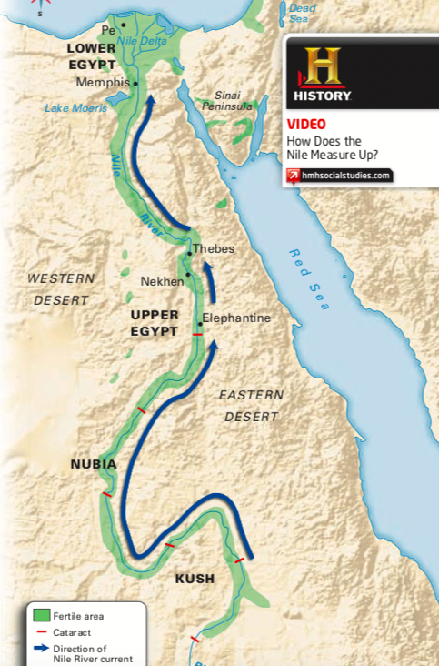
Location and Physical Features
The Nile River is the longest river in the world
It begins in central Africa and runs 4,000 miles north to the Mediterranean Sea
Ancient Egypt set up camp along a 750 mile stretch of the Nile River
Egypt had two regions: southern region (Upper Egypt) and northern region (Lower Egypt)
Due to the terrain of Egypt, cataracts (strong rapids) formed in the river
The cataracts made it difficult to navigate the river by sailing

Slide 4
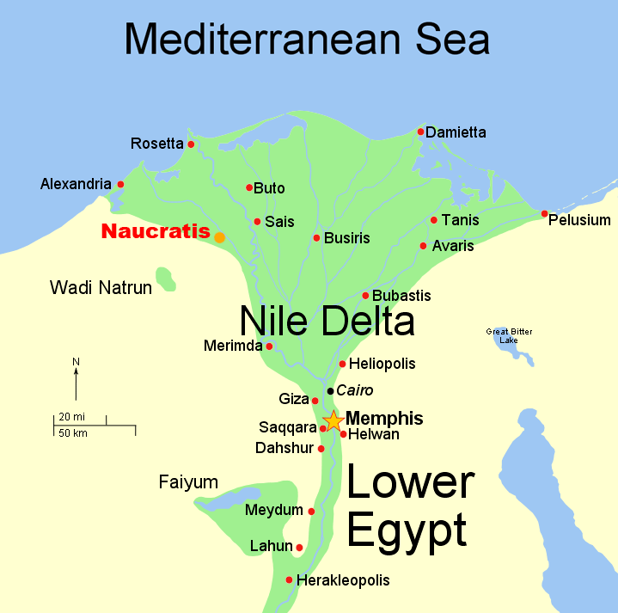
Lower Egypt had several branches that fanned out and created a delta
Delta = triangle shaped area of land made of soil deposited by a river
Two-thirds of Egypt's fertile farmland was located in the Nile Delta
Due to the little rain, most of Egypt was a desert.
Hunter-gatherer groups moved into the Nile Valley more than 12,000 years ago
They hunted wild animals, fish and used plants to survive
Wheat, barley, fruits, vegetables, cattle, sheep, fish, geese, ducks, etc.
Farmers in Mesopotamia developed the irrigation system and canals
Not only did the Nile River provide ample resources, but it made it very difficult to invade Egypt due to the natural barriers
The desert was hard to cross, the seas (Mediterranean and Red) were difficult to navigate, and the river itself was harsh to walk through.
Due to the success of farming in Egypt, two kingdoms developed—Lower Egypt and Upper Egypt

Slide 5
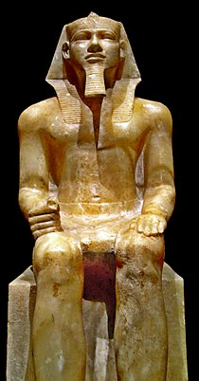
Kings Unify Egypt
Menes was considered to be Egypt's first pharaoh
His family was Egypt's first dynasty
Menes built a new capital city at the Delta
Menes' dynasty lasted about 200 years
Pharaoh's after him wore a double crown to symbolize the unification of upper and lower Egypt
Menes
King of Upper Egypt
Wore a white cone-shaped crown
Came into power in 3100 BC
His goal was to unify upper and lower Egypt (He succeeded)
He showed the unification by wearing a double crown—red and white
Red symbolized upper Egypt and white symbolized lower Egypt

Slide 6
Section 2
The Old Kingdom

Slide 7
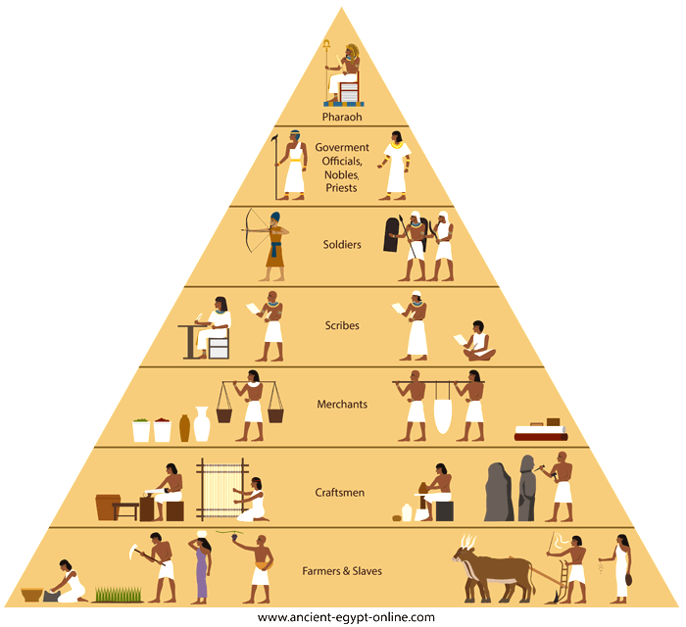
Rule by Pharaohs
The Old Kingdom was a time period in Egyptian history that lasted from about 2700 BC to 2200 BC
Their political system was based on the belief that the pharaoh was both a king and a god
The most famous pharaoh of the Old Kingdom was Khufu
He ruled in the 2500s BC
In 2200 BC, Egypt had about 2 million people
At the top of their society was the pharaoh
Upper class: priests and key government officials (nobles)
Middle Class: lesser government officials, scribes, craftsman, and merchants
Lower Class: made up 80% of the population. Consisted of farmers.

Slide 8
Egypt and Religion
Egyptian religion was mainly focused on what happened after you died
Egyptians followed polytheism
The gods represented everything from the sun, sky, and earth
There was a focus on afterlife and believed it was a happy place
The belief was that when you died, your body became a force. The spirit left your body and would stay at your burial site.
To "feed" the spirit, the family of the dead would bring food and water to the burial site, as well as clothing and jewelry.

Slide 9
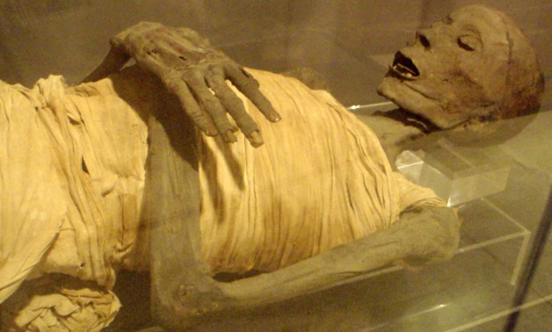
Burial Practices
Egyptians developed a processed called embalming, which allowed bodies to be preserved for many years
Embalming made bodies to become mummies
If a body was not embalmed, it would decay at a very rapid rate
Embalming took weeks to complete, then the body was wrapped with linens and placed into a coffin
Typically only the elite in society could afford to have this process happen

Slide 10
Pyramids
Burial sites were important
The most spectacular burial sites were the pyramids, which were built during the Old Kingdom
The largest pyramid is in Giza. It covers more than 13 acres and stands 481 feet high
Historians still aren't entirely sure how the Egyptians built the pyramids
It took an immense amount of time, slaves, and engineering to complete
The pyramid's shape, pointing to the sky, represents the pharaoh's journey to the after life

Slide 11
Section 3
The Middle and New Kingdoms

Slide 12
The Middle Kingdom
The Middle Kingdom, a period of order and stability that lasted until about 1750 BC
The Middle Kingdom ruled for 160 years after the Old Kingdom had fallen
Towards the end of the Middle Kingdom, Egypt was in internal disorder
An outside group, Hyksos invaded Egypt using horses and chariots
They ended up conquering Lower Egypt, which they ruled for 200 years

Slide 13
The New Kingdom
The Egyptians fought back against the Hyksos and eventually Ahmose rose to power
This period was when Egypt reached the height of its power and glory
In order to keep control, Egypt began to control all the trade routes coming in and out of Egypt
Egypt had the largest and strongest army in the region
Queen Hatshepsut increased Egyptian trade and made Egypt incredibly wealthy
She has a monument and temple built in the city of Thebes

Slide 14
Invasions
Even though Egypt was very strong, they were not unchallenged
In 1200s BC, Ramses II came into power in Egypt
Had one of the longest reigns in Egyptian history
He fought the Hittites, a group from Asia Minor
Ramses built forts to strengthen the outside of the city from invasions

Slide 15
Work and Daily Life
Farmers and Peasants
Bottom of social scale
Made up the majority of the population
Gave food as money for taxes to pharaohs
Slaves
Worked on farms, building projects, and in houses
Could earn their freedom back after some time
Family Life
Were expected to marry and have a family
Women were devoted to their homes and children
Women had some rights—like making contracts, divorce
Children went to school, but most boys left school at 14 to work with their fathers
Scribes
They were honored in society
Worked for government and temples
Kept records and accounts
Many were wealthy
Artisans, Artists, and Architects
Had advanced skills
Sculptors, builders, carpenters, jewelers
Architects built buildings/temples
Artists worked on painting inside tombs
Soldiers
Professional military
Received land as payment

Slide 16
Section 4
Egyptian Achievements

Slide 17
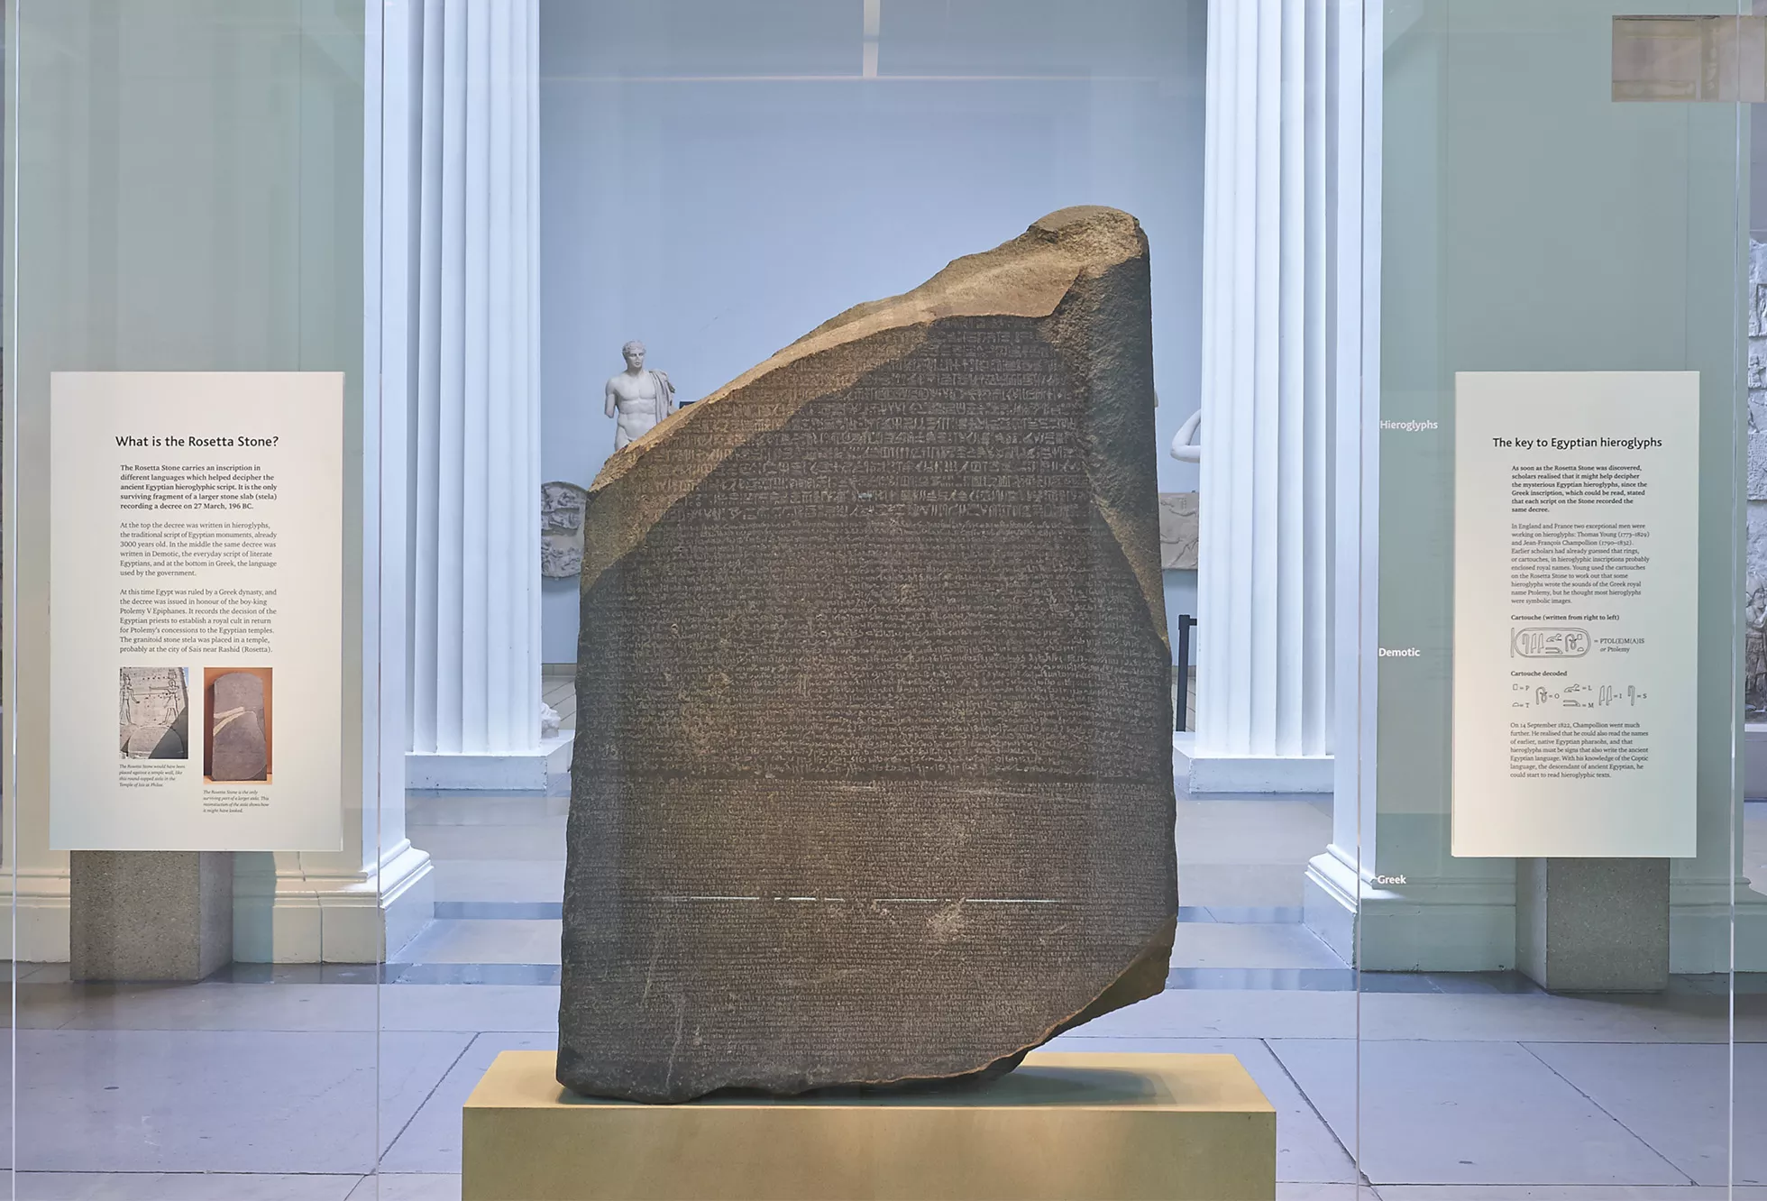
Egyptian Writing
Hieroglyphics—Egyptian writing system
Had more than 600 symbols (pictures and objects)
Could be written horizontally or vertically or written from left to right
This made it very hard to read
One of the world's first writing systems
Earliest writing was around 3300 BC carved into stone or hard materials
Later, they learned how to make papyrus, or paper like material
The Rosetta Stone
A stone slab that had hieroglyphics
Found in 1799
Written in hieroglyphics and greek

Slide 18
Temples, Tombs, and Art
Temples
Were homes to the gods
People visited temples to worship, offer the gods gifts
Sphinxes—imaginary creatures with the bodies of lions and the heads of other animals or humans
Lavishly decorated
Tombs
In 1922, King Tut's tomb was found with treasures (robes, jewelry, ivory statues, etc.)
Egyptians have intense burial practices and beliefs
Art
Lively, colorful paintings
Covered walls of temples and tombs
Always shows people's head from side and upper body are shown straight on

