Slide 1
ABOUT
ME
OUR
ROOM
CONTACT

Slide 2
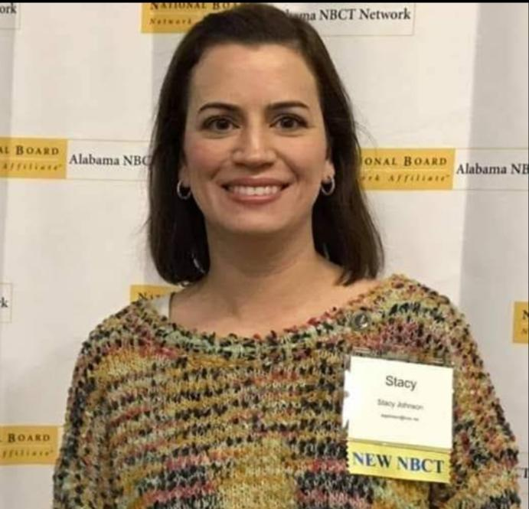
Stacy JOhnson
I am so excited to have you in my room this year! I have taught 2nd-4th grades, but 2nd is my FAVE! You will learn so much this year!
I have 2 daughters: Lily (15, BHS) and Hope (13, BMS). I love to read and cook. If you see me out of school, it will probably be at Target or Chick-fil-A!

Slide 3
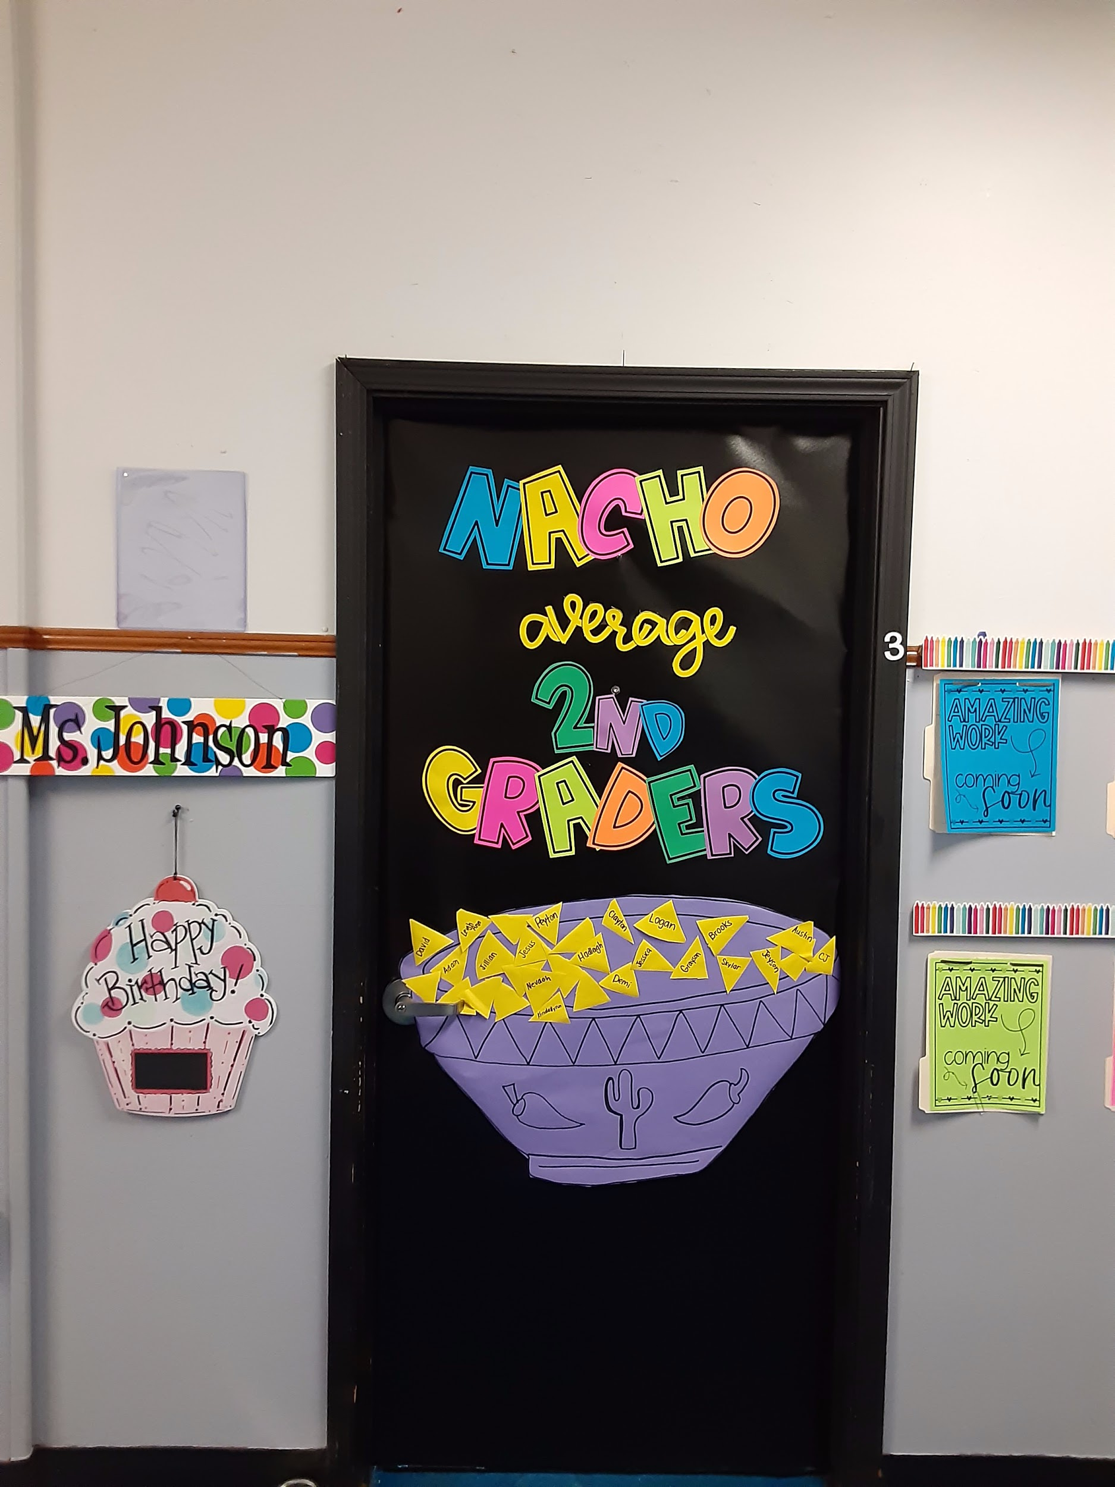
Our room is beside the lunchroom (Mrs. Harper’s old room). We are across from the 2nd grade restrooms.

Slide 4
SSJOHNSON@TCSS.NET
Join Remind
Text @fah62f6 to 81010
205-342-2697

