Slide 1
Unit 1—Statistics/Scientific Method/Biochemistry
PowerPoint

Slide 2
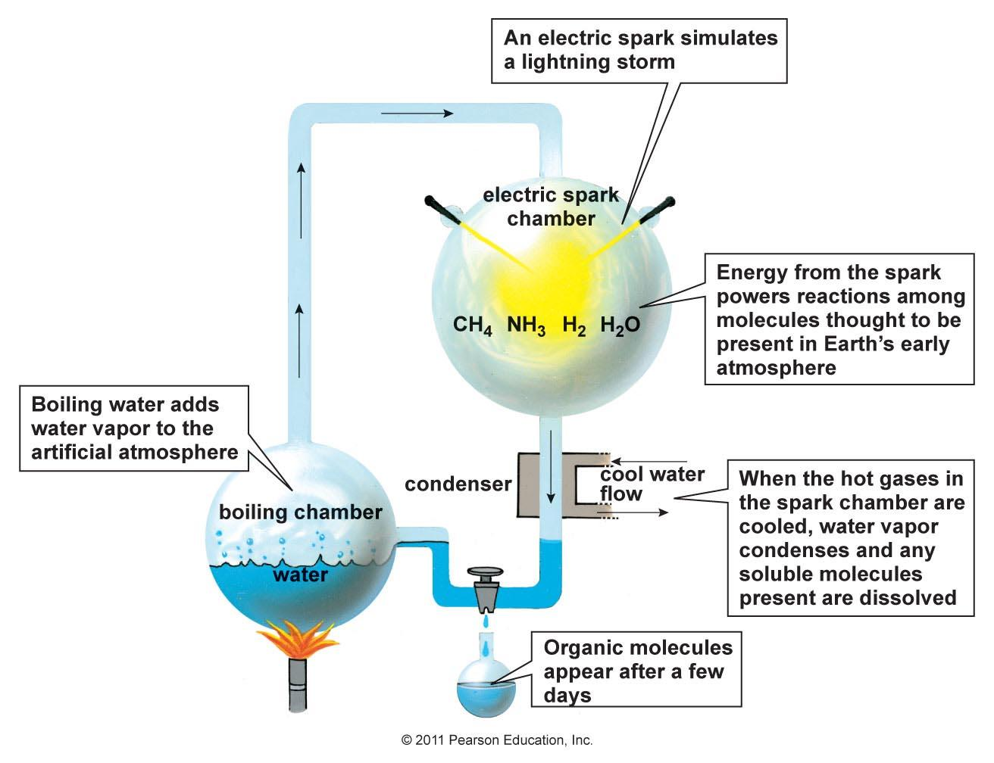
Miller—Urey Experiment--1953
Miller/Urey Experiment (Took place in 1953.)
Miller/Urey took inorganic substances that were thought to have been present in Earth’s early atmosphere (H2O vapor, H2, NH3, CH4) and created organic amino acids and oils. (CO2 and CH4 are not considered organic compounds, even though they contain Carbon.) Miller wanted to show that organic molecules, which are necessary for life, could be created by non-living things.

Slide 3
Scientific Method
The Scientific Method
This is a series of steps followed to solve problems. The steps are not always the same for each question you are researching and may not be followed in a linear pattern. The scientific method might better be illustrated by the diagram included below:
Step 1: State your Problem/Question
1. Develop a question or problem that can be solved through experimentation.
2. Make sure it is something that interests you.
Step 2: Make Observations/Do Research
1. Make observations – the act of seeing an object or an event and noting the physical characteristics or points in
the event. Observation is an extension of our senses; when we observe, we record what is seen, smelled,
tasted, heard, and touched.
a. Qualitative observations - These describe an object’s characteristics, properties, or attributes. (For example, in the state, “The apple is red,” red is a qualitative observation of the apple’s appearance.)
b. Quantitative observations – These involve a quantity or an amount. (In the statement,
“The apple weighs 125 grams,” 125 grams is a quantitative observation of the apple’s appearance.) Quantitative data refers to numerical or measured data.
c. Inferences – conclusions based on observations. Inferences go beyond what we
can directly sense. (Example: You make an inference when you use clues from a story to figure out something the author doesn’t tell you.)
d. Predictions- using observations, inferences, and/or trends in data to predict what will happen in the
future.
(Example: If, on a sunny day, you observe a massive line of dark clouds quickly advancing, what prediction can you make?)
2. Do research – In this step, we are talking about doing literature research, not lab-based research. Scientists should read about the research that has already been done on the topic by searching the Internet and scientific journals. Good quality research helps in developing an excellent hypothesis.

Slide 4
Scientific Method
Step 3: Formulate a Hypothesis
A hypothesis is a prediction or possible answer to the problem or question.
It is a relationship between the Independent variable and Dependent variables.
Independent Variable (manipulated variable) – the factor that is intentionally varied/tested by the experimenter.
Dependent Variable (responding variable) – the factor that may change as a result of changes made in the independent variable (the outcome).
Example: Let’s say that a scientist wanted to know if the use of miracle-gro affected the height of tomato plants. The independent variable in the experiment would be the amount of miracle-gro applied to the plants. The dependent variable would be the height of the plants.
The hypothesis needs to be written as an “If…then” statement.
The “If” part of the statement should describe what is done to the independent variable.
The “then” part of your statement is the prediction of what will happen to the dependent variable.
Example: If miracle-gro is applied to tomato plants, then they will grow taller.

Slide 5
Scientific Method
Step 4: Experiment
The scientist must develop and follow a procedure that anyone can follow.
Use precise directions.
Include a detailed materials list.
The outcome must be quantifiable (measurable).
The experiment must have a control group.
The control group may be a “no treatment” or an “experimenter selected” group to use as a standard of comparison for the independent variable.
A negative control group is a control group that is not exposed to the experimental treatment or to any other treatment that is expected to have an effect.
For example, imagine that you wanted to know if some lettuce carried bacteria. You set up an experiment in which you wipe lettuce leaves with a swab, wipe the swab on a bacterial growth plate, incubate the plate, and see what grows on the plate. As a negative control, you might just wipe a sterile swab on the growth plate. You would not expect to see any bacterial growth on this plate, and if you do, it is an indication that your swabs, plates, or incubator are contaminated with bacteria that could interfere with the results of the experiment.
A positive control group is a control group that is not exposed to the experimental treatment but that is exposed to some other treatment that is known to produce the expected effect.
As a positive control, you might swab an existing colony of bacteria and wipe it on the growth plate. In this case, you would expect to see bacterial growth on the plate, and if you do not, it is an indication that something in your experimental set-up is preventing the growth of bacteria. Perhaps the growth plates contain an antibiotic or the incubator is set to too high a temperature.
Example: In the miracle-gro experiment described above, the negative control group would consist of plants that are not exposed to any miracle-gro.
The control group is exposed to all of the same factors as the experimental group(s) except for the independent variable being tested.
Experimental group – group or groups that have the independent variable applied/manipulated.
Example: In the miracle-gro experiment, the experimental group would consist of a group of plants that are treated with miracle-gro. We might treat different subgroups with different amounts of miracle-gro to test the effect of concentration.
Constants – all the factors that the experimenter attempts to keep the same/control in all of the groups in the experiment.

Slide 6
Scientific Method
Step 5: Collect Data
You must write down results (measurements, observations, temperatures, times, etc.) as you perform your experiment.
Qualitative Data - observations (using senses) written in note form.
Quantitative Data- numerical measurements and calculations.
SI Units must be included on all measurements.
2. Must be kept orderly in a table or chart.
3. Modify the procedure if needed.
Step 6: Analyze Data
A. Confirm the results by retesting, if possible.
B. Trials – the number of times you repeat the experiment.
1. The more trials you can do, the more reliable the results.
C. Convert results to a graph that is appropriate for the experiment.
D. Use both descriptive and inferential statistics to help make a conclusion.

Slide 7
Scientific Method
Step 7: Conclusion
A. The written results of the experiment.
B. Include a statement if the hypothesis was supported or refuted.
C. Make recommendations for further study and possible improvements to the procedure.
Step 8: Communicate Results
Be prepared to present the project to an audience. Scientists share information through media, journal articles, and lectures.

Slide 8
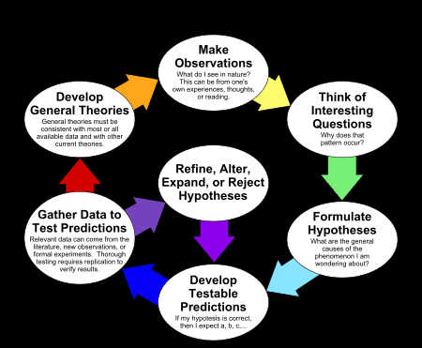
Scientific Method

Slide 9
Graphing
Graphs and charts communicate information visually. They can show patterns, help scientists identify correlations, and get the point of the experiment across quickly.
The independent variable is plotted on the x-axis
The dependent variable is plotted on the y-axis.
The mnemonic DRY MIX, for “dependent, responding, y-axis” and “manipulated, independent, x-axis,” can help you remember this pattern.
Label both axes (independent variable on the X-axis and dependent variable on the Y-axis)
Include units on both axes. Enclose the unit in parentheses.
Provide a descriptive title. Use the pattern, “The Effect of the independent variable on the dependent variable”. For example if you were graphing the miracle-gro concentration against plant height. The title of the graph might be “The Effect of Miracle-Gro Concentration on Plant Height”.
If the instruction is to plot rather than graph the data points, no line needs to be drawn.
If a line is drawn, do not extend the line beyond the last point plotted (unless asked to make a prediction) or connect the line from the origin (unless there is a time zero reading.)
If multiple lines are drawn on the same graph, label each line clearly.
Use a line of best fit when appropriate.

Slide 10
Graphing
A) Line Graph: are used for looking at the relationship between two continuous types of data. Typically, both the independent and dependent variables are numerical.
B) Bar Graphs: are used for making comparisons between discrete cases or to look for trends, such as over space or time. The independent variable is usually a category and the dependent variable is usually an average, percentage, or frequency.
C) Scatter Plot: Scatter plots are used for examining relationships between two types of data. These are very similar to line graphs, just without the line.
Line graphs provide an excellent way to map independent and dependent variables that are both quantitative. When both variables are quantitative, the line segment that connects two points on the graph expresses a slope, which can be interpreted visually relative to the slope of other lines or expressed as a precise mathematical formula. Scatter plots are similar to line graphs in that they start with mapping quantitative data points. The difference is that with a scatter plot, the decision is made that the individual points should not be connected directly together with a line but, instead express a trend. This trend can be seen directly through the distribution of points or with the addition of a regression line or line of best fit.
Determine the rate from a graph
The AP Biology exam often asks students to find the rate of a process or reaction between two points on a graph.
In order to find the rate, calculate the slope of the best fit line that connects the two points. Use m=y₂-y₁/x₂- x₁

Slide 11
Free Response Section
Free Response Section—10 minute outlining/planning period followed by an 80 minute writing period.
Students can begin to write their actual answers during the outlining/planning period.
This section includes two long free response questions (worth 8-10 points each) and 4 short free response questions worth 4 points each.
The two long free response questions each typically require answers that are 2-3 solid paragraphs long.
Free Response Question 1 will always deal with “Interpreting and Evaluating Experimental Results”. This question will require students to: A) Describe and explain biological concepts, processes, and/or models, B) Identify experimental design procedures, C) Analyze data, D) Make and justify predictions.
Free Response Question 2 will always deal with “Interpreting and Evaluating Experimental Results With Graphing”. Students will be given a scenario and a table of experimental data and will be asked to: A) Describe and explain biological concepts, processes, or models, B)Construct a graph, plot, or chart and use confidence intervals or error bars, C) Analyze data, D) Make and justify predictions.
Free Response Question 3 will deal with “Scientific Investigation”. The question will provide students with a description of a lab investigation scenario and ask them to: A) Describe biological concepts or processes, B)Identify experimental procedures, C)Predict results, D) Justify predictions.
Free Response Question 4 will deal with “Conceptual Analysis”. The question will provide students with a scenario of a biological phenomenon with a disruption. The question will ask students to: A)Describe biological concepts or processes, B)Explain biological concepts or processes, C)Predict the causes or effects of a change in a biological system, D)Justify predictions.
Free Response Question 5 will require students to “Analyze Models or Visual Representations”. The question will assess students’ abilities to: A) Describe characteristics of a biological concept, process, or model represented visually, B)Explain relationships between different characteristics of a biological concept or process represented visually, C)Represent relationships within a biological model, D)Explain how a biological concept or process represented visually relates to a larger biological principle, concept, process, or theory.
Free Response Question 6 deals with “Data Analysis”. The question will present students with data in a graph, table, or visual representation . The question will ask students to: A)Describe the data, B)Use data to evaluate a hypothesis or prediction, C)Explain how experimental results related to biological principles, concepts, processes, or theories.
Each of the 4 short free response questions can usually be answered in a single solid paragraph.
Student responses must be written in complete sentences and should be written in black ink. Students should answer each section of a free response section separately (1A, 1B, 1C, etc…). Section Responses should be clearly labeled.
Introduction and conclusion paragraphs should not be included. Students should not restate the question in their answers.
The two sections of the exam (MCQ and FRQ) are waited equally to determine the final AP exam score.

Slide 12
Tips for the Free Response Section
Be sure to use the ten minute reading/outlining period advantageously. Carefully read all of the free response questions and map out/outline your answers. Include your map/outline on the test booklet beside each question prompt. These maps will NOT be graded, but you can use them to write your responses.
Before you begin to answer the question, make sure that you carefully read the question prompt thoroughly. Answer the question asked and nothing else.
Underline the important terms in the question such as “OR” and “CHOOSE 2”and the power verbs such as “DESCRIBE,” “IDENTIFY,” “LABEL,” “CONSTRUCT,” “DESIGN,” or “EXPLAIN.” The verbs usually indicate where points can be earned.
If a question says to choose 2, list 2, or describe 2 only discuss 2 answers. Only the first 2 answers on the paper will be graded. Don’t waste time including extra answers that will not be read.
Use the entire 90 minutes to write thorough responses to all eight questions. Use all of your time. Don’t give up. There will be parts of every question that you should be able to answer. Be sure to answer those parts.
Pay particular attention to words like:
Discuss: give reasoning pro and con; analyze carefully
Analyze: summarize in detail with a selected focus
Explain: clarify and interpret; give reasons for differences, analyze causes
Compare/contrast: emphasize both the similarities and differences
Relate: show how ideas or concepts are connected to each other
Justify: Back up your assertions/points with data.
Write as legibly as possible, using black ink. The papers are shuffled quite a bit when they are scored, and answers written in pencil may be smeared. If the person scoring your essays cannot read what you have written, then you will not earn any points. Do use a pencil to create all graphs. When the graph is complete and correct, outline over the response in pen.
Clearly mark your answer sheet with the number/section of the free response question you are answering. Write freely on the response sheet—use several sheets as needed. Make sure that each sheet is clearly labeled.
Organize your free response answers using the format provided in the question—write “1a‟ and then respond to “1a”; write “1b‟ then respond to “1b”, etc…

Slide 13
Tips for the Free Response Section
Use graphs or diagrams when it will enhance your essay response. However, unless the prompt specifically asks for drawings/graphs, every thought you hope to convey must also be put in writing.
Label all graphs correctly.
Include a graph title.
Include a key/legend which clearly identifies lines and data points.
Label axes (including units).

Slide 14
Tips for the Free Response Section
The AP Biology exam will often ask you to design an experiment to address a certain topic/question. When asked to design an experiment, always include the following elements in your answer:
Form a concise hypothesis which is testable. State It Clearly! Use the if…then format. For example: If tomato plants are exposed to increased amounts of Miracle-Gro, then they will grow taller.
Describe the control group that you will use for comparison with the experiment. In most cases, you should use a negative control group. A negative control group uses the same procedures as the experimental group, but is treated with a placebo (instead of the independent variable) or given no treatment at all. This is predicted to produce no change to results of interest to the experiment. If you were testing the effects of fertilizer on the growth of plants (in terms of height), the plants in your negative control group would be given no fertilizer. In some cases, positive control groups are used. Subjects in positive control groups are given a treatment that is known to cause a certain result. For example: A scientists testing the effects of a new headache medication might use a positive control group in which the subjects are treated with aspirin instead of the new medication.
Explicitly identify the independent variable.
Explicitly identify the dependent variable.
Identify at least 3-4 variables that you will use as constants.
Describe the basic procedure that you will use. Describe the measurements that you will take, the # or subjects that you will use, and how the subjects were assigned to either the control or experimental groups. This should usually be random.
Stress the importance of a large sample sizes.
Mention that you will conduct multiple trials.
Describe the statistical tests that you will use to interpret the data (Chi Square, rate determination…).
Graph: Choose an appropriate graph. Use the guidelines included above.
Make a prediction about the expected outcome and a rationale for your prediction.

Slide 15
Graphing Tips
The independent variable should be plotted on the x-axis
The dependent variable should be plotted on the y-axis.
The mnemonic DRY MIX, for “dependent, responding, y-axis” and “manipulated, independent, x-axis,” can help you remember this pattern.
Label both axes (independent variable on the X-axis and dependent variable on the Y-axis)
Include units on both axes. Enclose the unit in parentheses.
Provide a descriptive title. Use the pattern, “The Effect of the independent variable on the dependent variable”. For example if you were graphing the miracle-gro concentration against plant height. The title of the graph might be “The Effect of Miracle-Gro Concentration on Plant Height”.
If the instruction is to plot rather than graph the data points, no line needs to be drawn.
If a line is drawn, do not extend the line beyond the last point plotted (unless asked to make a prediction) or connect the line from the origin (unless there is a time zero reading.)
If multiple lines are drawn on the same graph, label each line clearly.
Use a line of best fit when appropriate.

Slide 16
More Graphing Tips
Which Graph Type To Use?
A) Line Graph: are used for looking at the relationship between two continuous types of data. Typically, both the independent and dependent variables are numerical.
B) Bar Graphs: are used for making comparisons between discrete cases or to look for trends, such as over space or time. The independent variable is usually a category and the dependent variable is usually an average, percentage, count, or frequency.
C) Scatter Plot: Scatter plots are used for examining relationships between two types of data. These are very similar to line graphs, just without the line.
Line graphs provide an excellent way to map independent and dependent variables that are both quantitative. When both variables are quantitative, the line segment that connects two points on the graph expresses a slope, which can be interpreted visually relative to the slope of other lines or expressed as a precise mathematical formula. Scatter plots are similar to line graphs in that they start with mapping quantitative data points. The difference is that with a scatter plot, the decision is made that the individual points should not be connected directly together with a line but, instead express a trend. This trend can be seen directly through the distribution of points or with the addition of a regression line or line of best fit.
The slope of a line represents the rate of change of the dependent variable over the independent variable.
The AP Biology exam often asks students to find the rate of a process or reaction between two points on a graph.
In order to find the rate, calculate the slope of the best fit line that connects the two points. Use m=y2-y1/x2- x1
Be sure to include a unit with your answer. The unit for the slope/rate should be the y axis unit divided by the x axis unit.

Slide 17
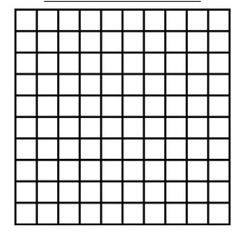
Graphs and Rate Practice
A+ College Ready Screencast on Graphing and Rate Calculations
An agricultural biologist was evaluating two newly developed varieties of wheat as potential crops. In an experiment, seedlings were germinated at 20 degrees Celsius for 48 hours. Oxygen consumption of the two-day-old seedlings was measured at 17 degrees Celsius. The data are included in the tables below. Graph both sets of data on the included graph paper. Calculate the rate of oxygen consumption for each variety between times 20 minutes and 80 minutes.
Variety A
Time (min) Oxygen Consumption (mL)
0 0
20 1.4
40 2.6
60 4.0
80 5.2
Variety B
Time (min) Oxygen Consumption (mL)
0 0
20 0.8
40 1.6
60 2.4
80 3.2

Slide 18
Statistics Review
See the A+ screencast for an explanation of standard deviation, standard error of the mean, 95% confidence intervals, and graphs with error bars.
https://youtu.be/npN92OxYFKs

Slide 19
Statistics Review
Descriptive statistics is used to estimate important parameters of the sample data set. Examples include sample standard deviation, which describes the variability in the data; measurements of central tendencies such as mean, median, and mode; standard error of the sample mean, which helps you determine your confidence in the sample mean and how well the sample mean represents the true population mean.
Inferential statistics includes tools and methods (statistical tests) that rely on probability theory and an understanding of distributions to determine precise estimates of the true population parameters from the sample data. This is a key part of data analysis and allows you to support and draw conclusions from your data about the true population.

Slide 20
Statistics Review
The standard deviation (SD or std ) (represented by the Greek letter sigma, σ for the population standard deviation or “s” for the sample standard deviation) is a measure that is used to quantify the amount of variation or dispersion of a set of data values. A standard deviation close to 0 indicates that the individual data points tend to be very close to the mean (also called the expected value) of the set, while a high standard deviation indicates that the data points are spread out over a wider range of values.
The standard deviation can be calculated using the formula included above and on the AP Biology formula sheet. You will not be asked to calculate the standard deviation on the AP Biology exam, but you should be able to use give standard deviations to analyze data sets.

Slide 21
Statistics Review
The standard error of the mean (SEM or Se_{x}) is an estimate of how far the sample mean is likely to be from the population mean, whereas the standard deviation of the sample is the degree to which individual data points within the sample differ from the sample mean. The standard error of the mean is calculated using the formula included above and on the AP Biology formula sheet. You will probably not be asked to calculate the standard error of the mean on an AP Biology exam, but you will be expected to use the standard error to analyze your data and construct appropriate graphs.
An interval within ±1 SEx of the sample mean describes the range of values about which an investigator can have approximately 67% confidence that the range includes the true population mean. Even better, a sample interval within ±2 SEx of the sample mean defines a range of values with approximately a 95% certainty that the true population mean falls within the interval. This interval is often referred at as a 95% confidence interval. You will be asked to graph 95% confidence intervals on a regular basis in this course.
The 95% confidence interval technique is an inference; it is a statistic that allows investigators to gauge just how good their estimate of the true population mean actually is. With this understanding, the investigator can establish ahead of time a reasonable sample size for this population and the degree of confidence needed. Note: The larger the sample size, the smaller the standard error and the more confident the researcher can be about the reliability of the data.

Slide 22
Statistics Review
The Standard Error of the Mean and the 95% Confidence Interval are used to construct error bars for graphs showing the mean values of data sets. In AP Biology, the error bars usually show the range 2 standard errors above and 2 below the mean value.
To create a graph with error bars, graph the means of each data set using a bar chart. Starting at the mean of the first bar, move directly up 2 times the SE_{x}. At that point, draw a horizontal line centered over the bar. Go back to the mean, and move directly down 2 times the SE_{x}. Again, draw a horizontal line that is in line with the line you drew above the bar. Connect the two horizonal lines with a vertical line through their centers.
Repeat the process for the other bars included in the chart.
The vertical space between the two horizontal lines represents a 95% confidence interval. This means that you can be 95% sure that the mean for the entire population falls within this interval.
As a researcher, you may want to use your collected data to compare samples/groups and to determine if the groups are “significantly different”.

Slide 23
Statistics Review
A "significant difference" means that the results that are seen in the data are most likely not due to chance or sampling error. In any experiment or observation that involves sampling from a population, there is always the possibility that an observed effect could have occurred due to sampling error alone. But if a result is "significant," the investigator may conclude that the observed effect actually reflects the characteristics of the population rather than just sampling error or chance. ​The standard error bars on a graph can be used to get a sense for whether or not a difference in two groups/samples is significant. Look for overlap between the error bars:

Slide 24
Statistics Review
When errors bars overlap quite a bit, it's likely that the difference between the two groups is not statistically significant and the differences are probably due to chance or sampling error. You must actually perform a statistical test to draw a valid conclusion, but in AP Biology you can simply say that if the error bars overlap that the two groups/samples are not statistically different.
On the other hand, if there is no overlap between the error bars, the differences between the two groups is likely to be statistically significant

Slide 25
Statistics Review
A hypothesis is a statement explaining that a causal relationship exists between an underlying factor (variable) and an observable phenomenon. Often, after making an observation, you might propose some sort of tentative explanation for the phenomenon; this could be called your working hypothesis. Because absolute proof is not possible, statistical hypothesis testing focuses on trying to reject a null hypothesis.
A null hypothesis (H₀) is a statement explaining that the underlying factor or variable is independent of the observed phenomenon—there is no causal relationship.
Stated another way, a null hypothesis (H₀₎ is usually a statement asserting that there is no difference or no association between variables. The null hypothesis is a tool that makes it possible to use certain statistical tests to figure out if another hypothesis of interest is likely to be accurate or not. For example, if you were testing the idea that sugar makes kids hyperactive, your null hypothesis might be that there is no difference in the amount of time that kids previously given a sugary drink and kids previously given a sugar-substitute drink are able to sit still. After making your observations, you would then perform a statistical test to determine whether or not there is a significant difference between the two groups of kids in terms of time spent sitting still.
The alternative hypothesis (H_{A}) to the null hypothesis might be that there is a difference between the two groups of kids in terms of time spent sitting still. Usually (but not always), an investigator is trying to find an alternative to the null hypothesis—evidence that supports the alternative hypothesis by rejecting the null (based on statistical tests). If the null hypothesis (that there is no difference between the two groups of kids in terms of time spend sitting still) can be rejected, then that is support for this alternative hypothesis.

Slide 26
Practice Problem Set 1
Three different children had lemonade stands in a small town. The numbers listed below are the number of cups of lemonade sold by each child during each week day (Ex. Child A sold 9 cups on Monday, 10 on Tuesday, 11 on Wednesday, etc.). Statistically analyze their results by answering the questions listed below the data sets (A, B, C). A = {9,10,11,7,13} B = {14,14,14,17,16} C = {1,1,10,19,19} a) Calculate the mean of each data set. b) Calculate the standard deviation of each data set. c) Which set has the largest standard deviation? d) What do the standard deviations tell you about the data?
e) Calculate the standard error of the mean for each data set.
f) Graph the means for the week for each child using a bar graph. Use error bars (based on the SEM) to depict 95% confidence intervals for each data set.
g) Based on the sample means and SEMs, identify the two populations/groups that are most likely to have statistically significant differences in the number of sales. Justify your answer.

Slide 27
Data Set A
Mean of Data set A = (9+10+11+7+13)/5 = 10 mean of Data set B = (14+14+14+17+16)/5 = 15 mean of Data set C = (1+1+10+19+19)/5 = 10
Standard Deviation=2.24
Standard Error of the Mean=1.00
X_{i}
9 | -1 | 1
10 | 0 | 0
11 | 1 | 1
7 | -3 | 9
13 | 3 | 9

Slide 28
Data Set B
Mean of Data set A = (9+10+11+7+13)/5 = 10 mean of Data set B = (14+14+14+17+16)/5 = 15 mean of Data set C = (1+1+10+19+19)/5 = 10
Standard Deviation=1.41
Standard Error of the Mean=0.63
X_{i}
14 | -1 | 1
14 | -1 | 1
14 | -1 | 1
17 | 2 | 4
16 | 1 | 1

Slide 29
Data Set C
Mean of Data set A = (9+10+11+7+13)/5 = 10 mean of Data set B = (14+14+14+17+16)/5 = 15 mean of Data set C = (1+1+10+19+19)/5 = 10
Standard Deviation=9.00
Standard Error of the Mean=4.50
X_{i}
1 | -9 | 81
1 | -9 | 81
10 | 0 | 0
19 | 9 | 81
19 | 9 | 81

Slide 30
Graph and Error Bars for Practice Problem Set 1

Slide 31
Practice Problem Set 1—Key Continued
c) Which set has the largest standard deviation? Data Set C d) What do the standard deviations tell you about the data? Data Set A’s standard deviation of 2.24 means that on average the individual data points vary about 2.24 from the mean 10. Data Set B’s standard deviation of 2.06 means that on average the individual data points vary about 2.06 from the mean of 15. Data Set C’s standard deviation of 9.00 means that on average the individual data points vary about 9.00 from the mean of 10. Data Set C has much more variation that the other two data sets.
g) Data sets A & B are the two data sets that are most likely to be significantly different in terms of the number of sales. This can be determined because the error bars in the 95% confidence interval graphs don’t overlap.

Slide 32
Statistics Question Set 2
You collected the following data in an experiment. During the experiment, you measured the height of plants grown at different fertilizer concentrations (20g/L of soil; 40g/L of soil). The heights of 4 plants grown at each concentration were:
20 g/L – 18 cm; 22 cm; 20 cm; 28 cm
40 g/L—32 cm; 24 cm; 29 cm; 23 cm
A. Calculate the mean for each group.
B. Calculate the standard deviation for each group
C. Calculate the standard error for each group.
D. Create a bar graph that illustrates the means of the two groups to within a 95% confidence interval ( sample mean +/- 2SEM).
E. Based on the sample means and SEMs, are these two populations/groups significantly different in terms of height? Did the fertilizer affect plant height? Justify your answer.

Slide 33
Mean for 20 g/L group=22
Mean for 40 g/L group=27
Data for Question Set 1
20 g/L – 18 cm; 22 cm; 20 cm; 26 cm
40 g/L—32 cm; 24 cm; 29 cm; 23 cm
X_{i}
18
22
20
26
-4
16
0
0
-2
4
4
16
Standard deviation=Square root of (36/3)=3.46

Slide 34
Calculations for 20 g/L Sample
Standard Deviation=s=3.46
SEM=Standard Error of the mean=(3.46/(square root of 4))=1.73

Slide 35
Data for Question Set 1
20 g/L – 18 cm; 22 cm; 20 cm; 26 cm
40 g/L—32 cm; 24 cm; 29 cm; 23 cm
Mean for 20 g/L group=22
Mean for 40 g/L group=27
X_{i}
32
24
29
23
5
25
-3
9
2
4
-4
16
Standard deviation=Square root of (54/3)=4.24

Slide 36
Calculations for 40 g/L Sample
Standard Deviation=s=4.24
SEM=Standard Error of the mean=(4.24/(square root of 4))=2.12

Slide 37
Me a n Height (cm)
20
40
Fertilizer Concentration (g/L)

Slide 38
Chi Square Analysis
See the A+ Chi Square screencast for more information about chi square analysis.
https://youtu.be/2yQ4xWqOqJY

Slide 39
Statistics Review
Chi Square Analysis--The Chi-square test is a statistical method that makes a comparison between the data collected in an experiment and the data an investigator expected to find. The Chi square test is a way to evaluate the variability that is always present in the real world to get an idea if the difference between the real and expected results is due to random chance or if some other factor is involved.
Chi square analysis can be used when you are comparing two or more categories of data. In AP Biology, the categories will usually be the observed and expected data. The actual data under these categories will typically be in the form of either counts or percentages. Chi square analysis should not be used to compare averages. For example, chi square analysis can be used to test how well the results of genetic crosses fit predicted outcomes based on Mendel’s laws of inheritance or to see how well measured gene frequencies in a population match up to Hardy-Weinberg predictions.
The chi square statistics for a data set can be calculated using the formula included above and on the AP Biology formula sheet. Sample chi square calculations can be found on the statistics review video and on upcoming slides in this presentation.
t test--A t-test is commonly used to determine whether the mean of a population significantly differs from the mean of another population. This is useful if you need to compare the means of control and experiment groups. In most cases in AP Biology, you are going to assume that the data is parametric (follows a normal distribution) and that the two samples are independent of each other.
ANOVA—Analysis of Variance--The one-way analysis of variance (ANOVA) is used to determine whether there are any statistically significant differences between the means of more than two independent (unrelated) groups.

Slide 40
Statistics Review
There are two different ways to interpret the meaning of the statistical tests. One way is to compare your calculated value to a critical value. You will need to use a chi square/t-test table to find this critical value. First, determine your degrees of freedom. The degrees of freedom are equal to your number of phenotypes/categories minus one.
We are always going to use the 0.05 significance level in Biology. The significance level, also denoted as alpha or α, is the probability of rejecting the null hypothesis when it is true. For example, a significance level of 0.05 indicates a 5% risk of concluding that a difference exists when there is no actual difference. This is essentially an error range.
Compare the critical value to the calculated chi square or t-test statistic. If the chi square/t-test statistic is greater than the critical value, we will reject the null hypothesis. This means that the differences between the two groups is statistically significant. If the chi square/t-test statistic is less than the critical value, we must fail to reject the null hypothesis. This essentially means that the differences between our two groups are small and likely due to chance.

Slide 41
Chi Square Formula and Critical Value Table

Slide 42
Statistics Review
The other way to interpret statistical tests is to use the p-value approach. Use a distribution table to find your calculated chi-square or t-test value. Make sure that you are looking in the row for the correct number of degrees of freedom.
Now determine the p value represented by this value. Use the column headings to get an estimate of the p-value.
The probability of whether the results of an investigation differ from the null results by chance alone is called the p-value. A p-value of 0.05 means that there is a 5% chance that the difference between the observed and the expected data is a random difference and a 95% chance that the difference is real and repeatable—in other words, a significant difference.
Therefore, if an investigator’s p-value is greater than 0.05, he or she would fail to reject the null hypothesis—that the difference between the observed results and the expected results is due to random chance and is not significant.
On the other hand, if the p-value is less than 0.05, the investigator would reject the null hypothesis. This would indicate that the differences between the observed and expected data are significant and likely due to something other than chance.
This same p-value approach is used with the t-test and ANOVA testing.

Slide 43
Chi Square example problem 1
The M&M company claims that its bags should contain 30% red, 20% brown, 10% yellow, 20% green, and 20% orange candies (Note: These are not the real distributions). After opening the bags and counting the contents, the following data were obtained: 50 red, 60 brown, 30 yellow, 40 green, and 20 orange.
State your null hypothesis for this data set.
Perform a chi square analysis on this data.
What critical value should you use?
Will you accept (fail to reject) or reject your null hypothesis?
What does this mean about your data?

Slide 44
Chi Square Table
Phenotype | O | E | (O-E) | (O-E)² | (O-E)²/E

Slide 45
Chi Square Table
Phenotype | O | E | (O-E) | (O-E)² | (O-E)²/E
Red | 50 | 60 | -10 | 100 | 100/60=1.67
Brown | 60 | 40 | 20 | 400 | 400/40=10
Yellow | 30 | 20 | 10 | 100 | 100/20=5
Green | 40 | 40 | 0 | 0 | 0
Orange | 20 | 40 | -20 | 400 | 400/40=10

Slide 46
Explanation for problem 1
Our Null Hypothesis for this problem should be: “There are no statistically significant differences between the observed and expected data sets.
To determine the expected values, multiply the percentages from the question stem by the total number of M & Ms in the sample.
Obtain the total number by adding up all the values in the observed (O) column.
For example: To get the expected value for red, multiple the expected percentage (in decimal form) (0.30) by the total number of M & Ms in our sample (200). This means that we expect 60 red M&Ms.
Fill in the Chi Square Table by completing the operations indicated by the column headers. To obtain the chi square statistic, add up all the values in the final column.
This gives us a chi square statistic (χ²) of 26.7.
We must compare the chi square statistic to the critical value. For this situation, we have 4 degrees of freedom (number of colors minus 1). We always use the 0.05 p value in AP Biology, so our critical value is 9.49.
Since our chi square statistic is higher than our critical value, we must reject the null hypothesis.
This means that our observed data is very different from our expected data and that the differences are too large to be simply due to chance.

Slide 47
Chi Square example problem 2
In the P generation, a female fruit fly homozygous for white eyes is crossed with a wild type male ( homozygous for red eyes).
All of the F1 male flies have white eyes and all of the F1 females have red eyes. Out of 100 F2 offspring, the following offspring were obtained: 23 wild type females, 26 wild type males, 25 white eyed females, and 26 white eyed males.
a. What is the most likely mode of inheritance for the white eye color trait? Why?
b. Draw a Punnett square that depicts the cross that produced the F1 flies described above.

Slide 48
Chi Square example problem 2 continued
c. Draw a Punnett square that depicts the cross that produced the F2 flies described above.
d. Out of 100 F2 offspring, how many were expected to be wild type males? Wild type females? White-eyed males? White-eyed females?
e. State your null hypothesis.
e. Construct a chi square analysis table for the F2 cross.
f. Calculate the chi square value.
g. How many degrees of freedom should you use?
h. What is the critical value?
i. What does your chi square analysis tell you about your data and hypothesis? Did you accept (fail to reject) or reject the null hypothesis?

Slide 49
Chi Square Table
Phenotype | O | E | (O-E) | (O-E)² | (O-E)²/E

Slide 50
Explanation for problem 2
The mode of inheritance of the white-eyed trait is X-linked recessive. The fact that males and females inherit the trait differently shows that the trait is sex-linked. Since females inherit the trait, it can’t be Y-linked. It is therefore an X-linked trait.
Since the F1 females inherited an X chromosome from both parents (one red and one white carrying X chromosome) and had the “red” phenotype, white must be recessive.

Slide 51
Punnett Square depicting F1 offspring
P Generation Parents
Females—X^{r}X^{r} Males--X^{R}Y
X^{r}
X^{r}
X^{R}X^{r} Red-eyed female | X^{R}X^{r} Red-eyed female
X^{r}Y White-eyed male | X^{r}Y White-eyed male
X^{R}
Y

Slide 52
Punnett Square depicting F2 offspring
F1 Generation Parents
Females—X^{R}X^{r} Males--X^{r}Y
X^{R}
X^{r}
X^{R}X^{r} Red-eyed female | X^{r}X^{r} White-eyed female
X^{R}Y Red-eyed male | X^{r}Y White-eyed male
X^{r}
Y

Slide 53
Chi Square Table
Phenotype | O | E | (O-E) | (O-E)² | (O-E)²/E
Red-eyed males | 26 | 25 | 1 | 1 | 1/25=0.04
White-eyed males | 26 | 25 | 1 | 1 | 1/25=0.04
Red-eyed females | 23 | 25 | -2 | 4 | 4/25=0.16
White-eyed females | 25 | 25 | 0 | 0 | 0

Slide 54
Explanation for problem 2 continued
Our Null Hypothesis for this problem should be: “There are no statistically significant differences between the observed and expected data sets.”
To determine the expected values, multiply the fractions from the F2 Punnett square by the total number of F2 fly offspring in the sample.
Obtain the total number by adding up all the values in the observed (O) column.
For example: To get the expected value for red-eyed males, multiple ¼ (the fraction from the Punnett Square) by the total number of F2 flies in our sample (100). This means that we expect 25 red-eyed F2 males.
Fill in the Chi Square Table by completing the operations indicated by the column headers. To obtain the chi square statistic, add up all the values in the final column.
This gives us a chi square statistic (χ²) of 0.24.
We must compare the chi square statistic to the critical value. For this situation, we have 3 degrees of freedom (number of phenotypes minus 1). We always use the 0.05 p value in AP Biology, so our critical value is 7.82.
Since our chi square statistic is less than our critical value, we must fail to reject the null hypothesis.
This means that our observed data is very similar to the expected data and that the differences are most likely due to chance.

Slide 55
Chi Square example problem 3
A researcher found that onion root tip cells spent approximately 90% of their life cycle in interphase and 10% in mitosis.
He then treated an experimental group of onion root tips with lectin and found that 700 of the onion root tip cells were in interphase and 1600 were in mitosis.
State a null hypothesis for the experiment.
Perform a chi square analysis on this data.
What critical value should you use?
Will you accept (fail to reject) or reject your null hypothesis?
What does this mean about your data?

Slide 56
Chi Square Table
Phenotype | O | E | (O-E) | (O-E)² | (O-E)²/E

Slide 57
Chi Square Table
Phenotype | O | E | (O-E) | (O-E)² | (O-E)²/E
Interphase | 700 | 2070 | -1370 | 1876900 | 906.71
Mitosis | 1600 | 230 | 1370 | 1876900 | 8160.43

Slide 58
Explanation for Problem 3
Our Null Hypothesis for this problem should be: “Lectin has no effect on the cell cycle of onion root tip cells.”
To determine the expected values, multiply the percentages from the question stem by the total number of onion cells in the sample.
Obtain the total number by adding up all the values in the observed (O) column.
For example: To get the expected value for interphase, multiple the expected percentage (in decimal form) (0.90) by the total number of onion root tip cells in our sample (2300). This means that we expect 2070 onion root tip cells to be in Interphase.
Fill in the Chi Square Table by completing the operations indicated by the column headers. To obtain the chi square statistic, add up all the values in the final column.
This gives us a chi square statistic (χ²) of 9067.14.
We must compare the chi square statistic to the critical value. For this situation, we have 1 degree of freedom (number of phases minus 1). We always use the 0.05 p value in AP Biology, so our critical value is 3.84.
Since our chi square statistic is higher than our critical value, we must reject the null hypothesis.
This means that our observed data is very different from our expected data and that the differences are too large to be simply due to chance. Our experiment indicates that lectin does have an effect on the cell cycle of onion root tip cells.

Slide 59
Chemistry Basics
Atom
The smallest unit of an element that maintains the chemical properties of the element.
Subatomic Particles
Proton – Subatomic particles that carry a positive charge. They are located in the nucleus of an atom.
The number of protons never changes in an element. The number of protons determines the identity of the element and defines the atomic number of the element.
Neutron - These particles carry NO charge (are neutral). They are also located in the nucleus of an atom and are similar in size to the proton.The number of neutrons can change. (Atoms of the same element with different numbers of neutrons are called Isotopes.)
Electrons - These subatomic particles carry a negative charge. They are located in the “Electron cloud”. The electrons are attracted to the positive protons in the nucleus, but can move within the electron cloud. The number of electrons associated with an atom can change. (Atoms with different numbers of electrons than the normal amount for that element are called Ions.)
Molecule
Two or more atoms that are covalently bonded together.
E levels or e- shells – Where the electrons are located within an atom or molecule.
Adding energy to the electrons makes them move farther out, away from the nucleus; losing energy causes them to move inward, toward the nucleus.
Valence Shell- Where the outer most electrons are located on an atom.
Valence e- - Refers to the outer most electrons. (These are the most important for chemical bonds and the chemical properties of an element or molecule.) Most elements need 8 valence electrons (an octet) in order to be chemically stable. Atoms react with other elements in order to obtain a total of 8 valence electrons and to become chemically stable.

Slide 60
Chemical Bonds
Occur between atoms.
Covalent Bonds
A type of intramolecular bond.
Results from the sharing of valence electrons between atoms.
Atoms held together by covalent bonds are called molecules.
Polar molecules carry a slight electrical charge at opposite poles (poles refers to the “ends” of the molecule) and non-polar molecules do not have an electrical charge.
Electronegativity
Refers to an atom’s desire to acquire electrons.
Hydrogen is the least electronegative atom.
Oxygen and Nitrogen are the most biologically important molecules with a high electronegativity.
Molecules which contain oxygen and nitrogen are likely to be polar.

Slide 61
Chemical Bonds
Ionic Bonds
Ionic bonds form between metal and non-metal atoms.
They form when the metal atoms loses electrons and the non-metal atom gains electrons.
Both atoms do this in order to have 8 valence electrons.
Compounds held together by ionic bonds are called salts.
Ionic Bonds are very strong when the compound is dry.
Ionic bonds are easily broken in water. This is why many salts dissolve easily in water to form ions.
Cations – Ions which possess a positive charge because they have more protons than electrons. The metal atoms in a salt typically become cations.
Anions –Ions which possess a negative charge because they have more electrons than protons. The non-metal atoms in a salt typically become anions.
Hydrogen Bonds
Hydrogen Bonds are fairly weak (compared to covalent and ionic bonds) intermolecular attractions that occur between polar molecules. They are often depicted as dots in chemical diagrams. Hydrogen bonding is very important in water due to its polar nature.
Van der Waals Interactions or London Dispersion Forces
These are temporary intermolecular attractions. (Usually a fraction of a second.)
These interactions are “created” when electrons clump on one side of an atom making that side temporarily “negative” and the other side “positive”. This allows other charged particles to attach momentarily. The electrons eventually unclump and the van der waals interactions disappear.

Slide 62
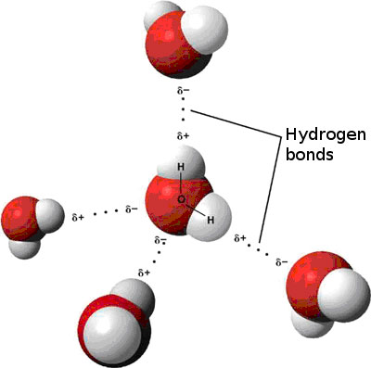
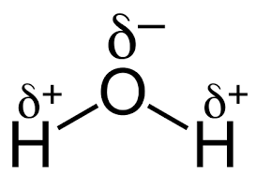
The Water Molecule
A+ Screencast on the Biologically Important Properties of Water
The water molecule is composed of 2 hydrogen atoms that are covalently bonded to a central oxygen atom.
Because of the high electronegativity of oxygen and the low electronegativity of hydrogen, the oxygen end of the water molecule has a slight negative charge, while the hydrogen end has a slight positive charge.
The water molecule’s shape is said to be “bent”. This shape means that one side of the molecule “the hydrogen side” is positive, while the other side “the oxygen side” is negative.
The polar water molecules form hydrogen bonds with each other. These bonds affect many of the biologically important properties of water.

Slide 63
The Biologically Important Properties of Water
Be sure that you can identify, explain the biological importance of, explain the chemical reasons for, and give real world examples of each of the following biologically important properties of water.
Important Properties of Water for Biology
Water has a high specific heat.
Specific heat refers to the amount of heat needed to change the temperature of 1 gram of a substance by 1 degree. Water’s specific heat is very high due to the hydrogen bonds that hold the water molecules together.
Due to its high specific heat, water is excellent for helping to maintain a constant internal body temperature. Large bodies of water have fairly constant temperatures. Water also helps to moderate the air temperatures of land masses located near large bodies of water.
Water is an excellent solvent.
Water is often referred to as the “Universal Solvent”. This means that it is great at dissolving other materials (solutes).
Due to its polarity, water is best at dissolving salts and polar molecules.
This is important in Biology, because it allows vital nutrients and gases to be dissolved and transported through the body and through the ground.
Water has a high heat of vaporization.
Heat of vaporization refers to the amount of heat needed to convert a liquid to a gas. Due to the many hydrogen bonds which hold water molecules together, the heat of vaporization is very high for water. When the water does eventually evaporate it carries heat away with it.
This is important in Biology, because it allows processes like sweating and transpiration to cool off organisms through the process of evaporative cooling.
Water is cohesive and adhesive.
Due to its polarity, water molecules stick to each other (cohesion) and to other polar molecules (adhesion). This property allows transpiration, the movement of water through the xylem of plants, to move water from the ground, through the plant, and eventually out into the air.
Water expands as it freezes.
Like most other compounds, the volume of water contracts as it cools down, but unlike most other materials, the volume of water begins to expand after it cools to temperatures below 4 degrees Celsius. This causes ice to be less dense than liquid water. This means that ice floats on liquid water.
This happens because the HYDROGEN bonds force the chains of water molecules further apart as the molecules cool down and slow down. This increased volume causes a decrease in density. This property is important to life, because as bodies of water freeze, the ice floats and insulates the liquid water underneath. This allows aquatic life to survive long, cold winters.

Slide 64
Organic Chemistry
A+ Screencast on Organic Biomolecules
Branch of science dealing with the element carbon and its many properties.
Most of the compounds found in living things, other than water, are organic.
About 30% of an organism’s dry weight (Biomass) is composed of Carbon found in the body’s organic molecules.
Carbon helps to make the 4 major groups of organic macromolecules: Carbohydrates, Lipids, Proteins, and Nucleic Acids.
The original source for Carbon in all life forms is Carbon Dioxide. (CO₂ - Photosynthesis)

Slide 65
Important Properties of Carbon
Important Properties of Carbon for Biology
Carbon has 4 valence electrons
Since carbon has 4 valence electrons, it can form four covalent bonds. This allows carbon to bond with a variety of molecules and form molecules with an almost infinite variety of shapes and functions.
Carbon atoms are small
Because carbon is a small atom, its valence electrons are near the nucleus. This means that when carbon forms covalent bonds, the bonds are strong. This makes carbon an excellent building material for life.
Carbon is abundant on Earth
Carbon isn’t the most abundant element on Earth, but there is a lot of carbon found on the planet. This makes it a good choice for the building block of life.

Slide 66
Organic Molecule Structure
Small organic molecules are called monomers.
Many biologically important organic molecules are very large macromolecules or polymers. These large molecules are formed by combining/bonding individual units called monomers.
The monomers are linked together by covalent bonds. Remember that covalent bonds are strong.
Macromolecules or polymers are formed by Dehydration Synthesis (also called Condensation) Reactions.
During these reactions, monomers are covalently bonded together.
The reactions release water as a byproduct.
Macromolecules are broken apart into individual monomers by Hydrolysis reactions. (“lysis” means “to split.”). In these reactions, water is used as a reactant.

Slide 67
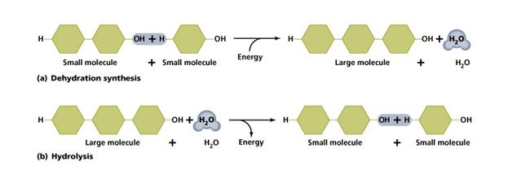
Dehydration Synthesis and Hydrolysis Reactions

Slide 68
Carbohydrates
Carbohydrates are sugars. In living things, carbohydrates serve as sources of quick energy and as structural/building materials. Most carbohydrate names end in the letters “-ose”.
Monosaccharides - Are the monomers or “building blocks” of carbohydrates. (“sacch” means “sugar”.) Glucose, fructose, galactose, ribose, and deoxyribose are common monosaccharides. The general molecular formula for a monosaccharide is (C_{N}H_{2N}O_{N}).
Polysaccharides - Are the polymers. These compounds are formed by the bonding together of several monosaccharides. Biologically important polysaccharides include:
Starch – Used as an energy storage molecule in plants.
Glycogen – Used as an energy storage molecule in Animals.
Cellulose – Used as a structural component of plant cell walls.
Cellulose is the most abundant organic compound on Earth. Due to the hydrogen bonds that occur in cellulose, it is very hard for most organisms to digest.
Chitin – Used as a component of the exoskeleton of some animals and also fungal cell walls.
Although starch, cellulose, and glycogen are all polymers of glucose, the molecules have different shapes. Some of these complex carbohydrates consist of straight chains of monomers, while others consist of branched chains. Because of the orientation of the glucose monomers, many hydrogen bonds form in cellulose and cause the molecule to be very strong and hard to digest.

Slide 69
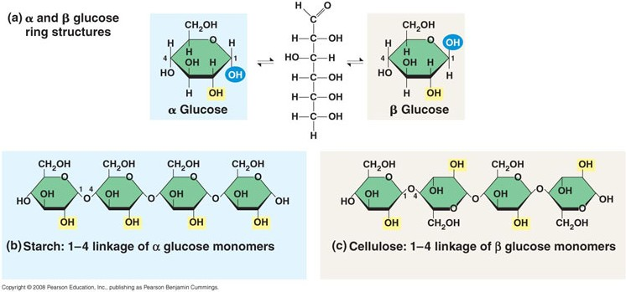

Slide 70
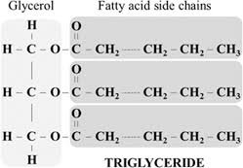
Lipids
These macromolecules are fats, oils, waxes, and steroids.
Most lipids are hydrophobic molecules. They contain little oxygen and are mostly nonpolar in nature.
Two Main parts of a lipid:
Fatty Acid—long chain of carbon and hydrogen atoms.
3 Carbon Glycerol molecule (alcohol) to hold the whole molecule together.
Lipids use a covalent bond called an Ester Linkage to hold the fatty acids and glycerol together.
Major Types of lipids:
Triglycerols or Triglycerides (These are your basic fat or oil.)

Slide 71
Lipids
The degree of saturation (lack of carbon—carbon double bonds) helps to determine the structure and function of many lipids.
Saturated fats--These fatty acids are saturated with Hydrogen atoms. The molecule has no open bonds to put any more Hydrogen on. There are no carbon—carbon double or triple bonds in these chains. Saturated fats are solids at room temp and they usually are associated with animals. Saturated fats contribute to coronary artery disease.
Unsaturated fats--These fatty acid chains contain some carbon-carbon double or triple bonds that “could be broken” to add more Hydrogen to the fatty acid. Saturated fats tend to be liquids at room temperature and they usually are associated with plants (vegetable oil, sunflower oil, or peanut oil). Unsaturated fats are typically viewed as a healthy part of the diet.
Polyunsaturated fats--These fats have many double or triple bonds in their fatty acid chains.
Hydrogenated or Trans fats. These are oils turned solid fats by adding Hydrogen and by breaking the double or triple bonds in the fatty acids. This was done in the past to change the texture, stability, and shelf life of fats. Trans fats were common in processed foods. They have been shown to increase LDL cholesterol levels and to contribute to coronary artery disease.

Slide 72
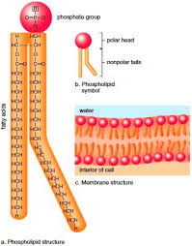
Lipids
Phospholipids
These molecules replace a single fatty acid chain from a triglyceride with a single Phosphate ion. The phosphate portion of the molecule is Hydrophilic because of the charge on the phosphate ion.
The remaining fatty acids chains are hydrophobic. They are mostly composed of long chains of carbon atoms that are also bonded to hydrogens. They are neutral and are not attracted to water.
Phospholipids are said to be amphipathic since they have both polar and nonpolar sides.
Phospholipid Bi-layers are important for the building of cell and organelle membranes.

Slide 73
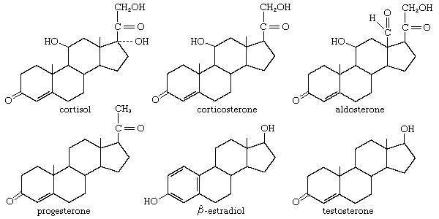
Lipids
Steroids
A steroid is a lipid composed of 4 carbon rings. Common steroids found in the body include testosterone, estrogen, progesterone, and cholesterol.
What makes them different from each other are the attached functional groups. These functional groups help determine the function of the steroid. Most of the steroids are built from cholesterol. Steroids function in the body as cell signals/hormones. Due to their lipid/nonpolar nature they can penetrate the cell membrane and bind to intracellular receptors. They often act to regulate the expression of certain genes.
Cholesterol is an important component of the cell membrane. It helps with cell membrane flexibility.

Slide 74
Proteins
Proteins are one of the most important categories of organic macromolecules found in living things. Proteins are serves as components of bone, muscle, skin, and hair. Many of the body’s chemical signal molecules are made of protein. Most of the body’s enzymes are proteins.
The only function of DNA is to code for the structure of the proteins needed by the body.
Proteins make up greater than 50% of an organism’s dry weight or biomass.
The names of most proteins end in “lin” while the names of most enzymes (which are composed of proteins) usually end in “ase”.
Proteins are large macromolecules which are composed of monomers “building blocks” called Amino Acids. There are 20 different Amino Acids used by living things to make proteins. Proteins and enzymes usually have hundreds to thousands of Amino acids in their structure.

Slide 75
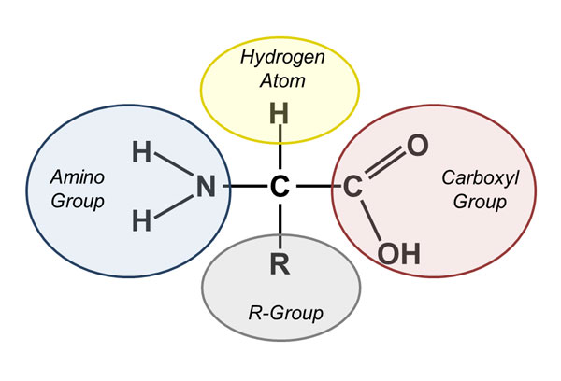
Proteins
Amino Acids have 4 different parts to them:
Amino end (NH2) – This end can act as a base by accepting a Hydrogen ion.
Carboxyl end (COOH) – This part acts as an acid because it can release a hydrogen ion.
Alpha (α) Carbon – This is the central carbon atom to which all of the other functional groups are attached.
R group - This part is the only part that is different in the 20 different amino acids. The R group gives different amino acids their distinctive properties.

Slide 76
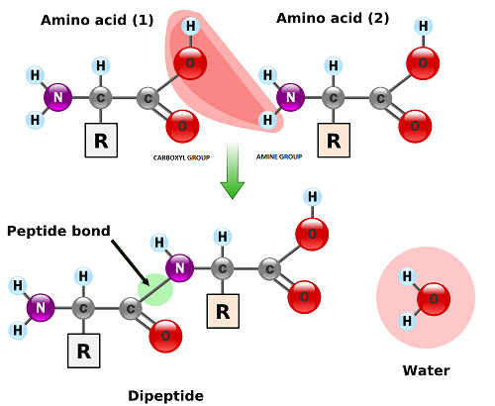
Proteins
Individual Amino Acids (monomers) are bonded together by a covalent bond called a peptide bond. The peptide bond is a covalent bond and is strong and hard to break.
In order to create a peptide bond, the amino end of one amino acid is positioned to combine with the Carboxyl end of the second amino acid. The amino acids are joined during dehydration synthesis reactions (also known as “condensation reactions”).
Two amino acids bonded together are referred to as a dipeptide. When more than two are bonded, the structure is referred to as a polypeptide chain.
A protein is typically made from several polypeptide chains that are wrapped together into a large 3-D unit.
The function of a protein is largely determined by its shape/structure.

Slide 77
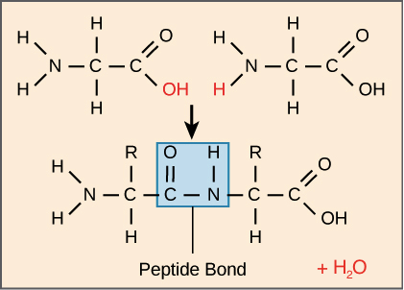
Directionality of Amino Acids/Polypeptides
Because of the structure of the amino acids, a polypeptide chain has directionality, meaning that it has two ends that are chemically distinct from one another.
At one end, the polypeptide has a free amino group, and this end is called the amino terminus (or N-terminus).
The other end, which has a free carboxyl group, is known as the carboxyl terminus (or C-terminus). The N-terminus is on the left and the C-terminus is on the right for the very short polypeptide shown on the left.
New amino acids are always added to the carboxyl terminus of a growing polypeptide chain.

Slide 78
Levels of Protein Structure
Primary Structure (Represented by the symbol - 1’. )
This refers to the sequence of bonded Amino Acids (which amino acids are present and what order are they in). The primary structure of each protein is coded for by DNA.
A mutation in the DNA can change the primary structure of a protein. This change can vastly change the overall shape of the protein and cause it to lose its function.
Secondary Structure (2’ )
This refers to the shape of specific sections of each polypeptide chain.
HYDROGEN bonding between polar amino acids allows for overlapping and coiling to occur in the “folding” of the protein into its 3-D shape. All proteins must be “folded” in order to work. The polarity/nonpolarity of the “R” groups of the protein’s amino acids determine how the protein will fold.
For proteins that are built by ribosomes located on the rough ER, this folding takes place within the Rough Endoplasmic Reticulum. These proteins are usually exported from the cell through the process of exocytosis (secretion).
Other proteins are constructed by ribosomes which float freely in the cytosol. These proteins typically remain within the cell in which they were made. The folding of these proteins usually takes place within a chaperonin. Chaperonins are protective structures that allows proteins to fold without water present.
Two common types of secondary structure are the alpha helix and the beta pleated sheet.

Slide 79
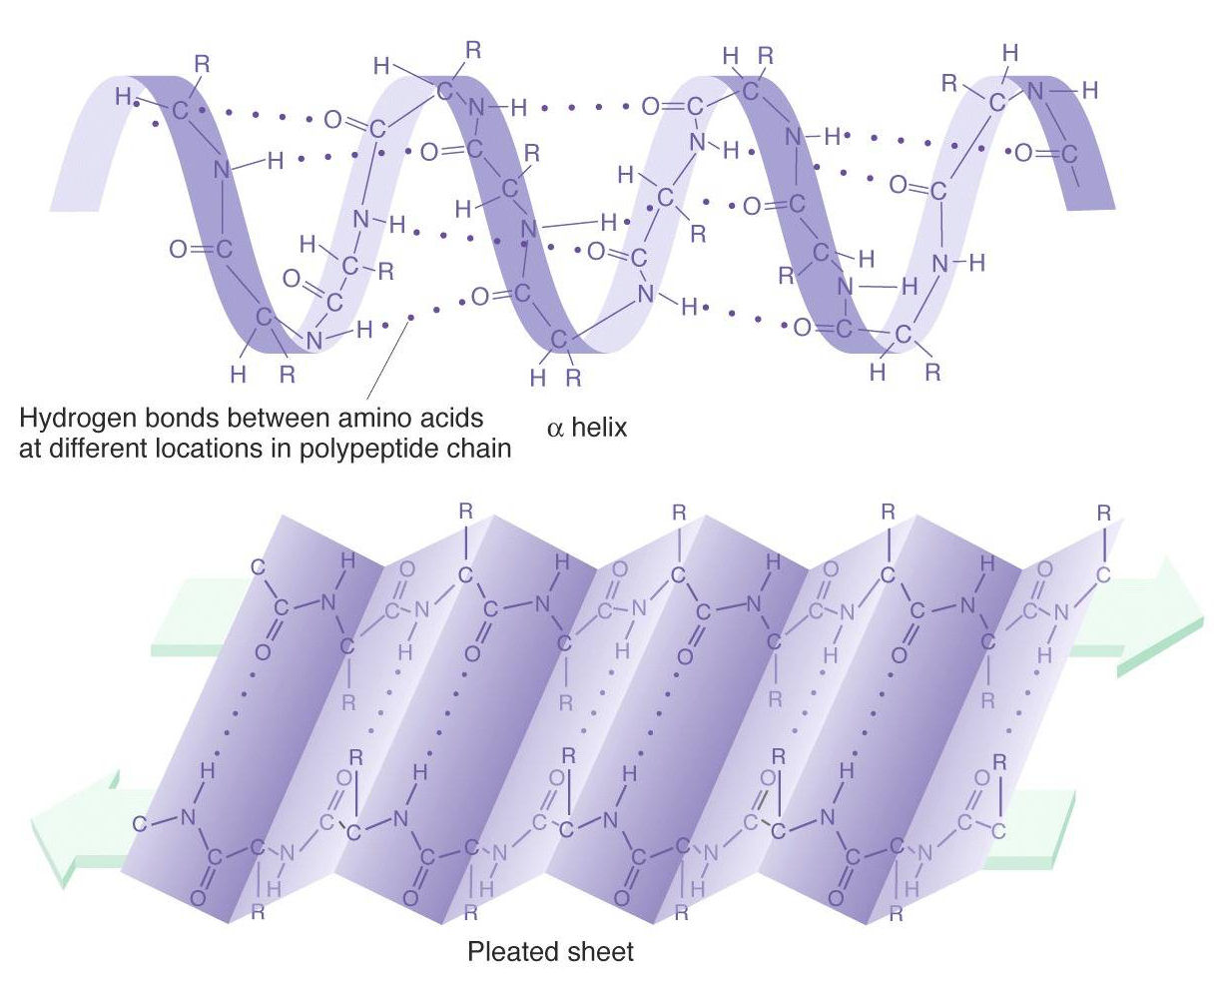
Types of Secondary Structures

Slide 80
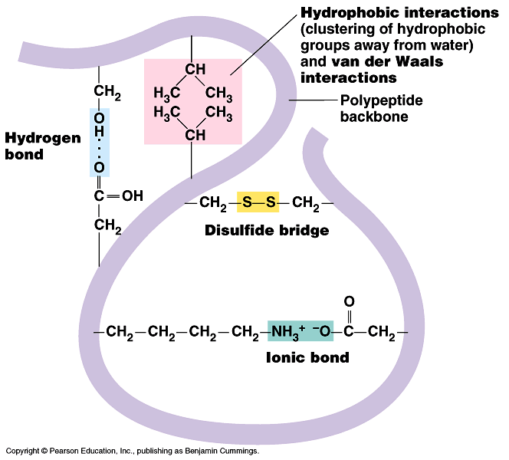
Levels of Protein Structure
Tertiary Structure (3’ ) (“Tert” means “third”)
This refers to the overall shape of each individual polypeptide chain.
Di-sulfide bridges help stabilize the protein’s folded structure. These bonds form when cysteines (a type of amino acid) are near each other in a polypeptide. These cysteines form a disulfide bond or bridge which is much stronger than a hydrogen bond.
The tertiary structure is also partially determined by ionic interactions between certain “R” groups and by hydrophobic interactions between certain R groups and water.

Slide 81
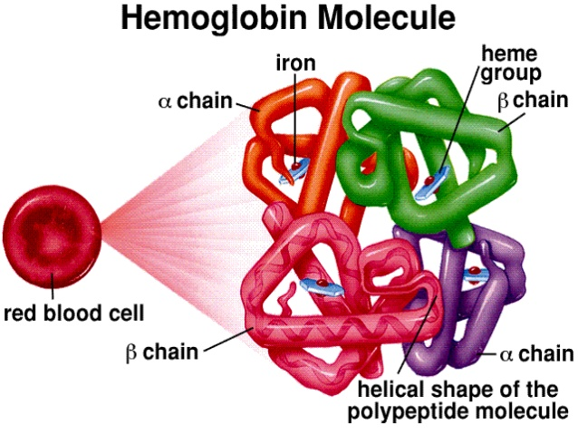
Levels of Protein Structure
Quaternary Structure (4’ )
This is when two or more polypeptides are woven together to form the overall structure of a protein.
Example: Hemoglobin -has four polypeptides woven together to make it.

Slide 82
Denaturation
Denaturation is the “unraveling” or “unfolding” of a protein or enzyme causing it not to function.
Denaturation can be caused by pH changes (up or down), salt concentration changes (up or down), and increases in temperature.
Denaturation usually disrupts the secondary and tertiary levels of protein structure by affecting either the hydrogen bonds or disulfide bonds which stabilize the structure.

Slide 83
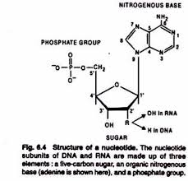
Nucleic Acids
Nucleic Acids function to store genetic information and/or to store and transfer energy. Common nucleic acids found living organisms include: DNA, RNA, ATP, cAMP, NADH, and NADPH.
The monomers of nucleic acids are called nucleotides. A nucleotide consists of a 5 carbon (pentose) sugar bonded to a phosphate group and a nitrogenous base.
DNA and mRNA are both polymers. DNA and RNA are the primary sources of genes and hereditary information.
DNA has Deoxyribose as its 5 Carbon sugar. DNA is double stranded. In eukaryotic cells, DNA is always stored inside a nuclear membrane or envelope. DNA’s function is to code for proteins. The sequence of the nitrogenous bases in the DNA determines the order of the amino acids in each of the body’s proteins.

Slide 84
Nucleic Acids
Watson and Crick were eventually able to determine that the DNA molecule is composed of two strands of nucleotides that are then twisted into a double helix. The individual strands are built when the phosphate groups of the nucleotides form covalent bonds with the deoxyribose molecules of adjacent nucleotides. The actual bonds form when one deoxyribose attaches to another by connecting its 5' carbon to the 3' carbon of the next sugar in the next nucleotide using a phosphate group. The alternating sugars and phosphates form the “backbone” of the DNA molecule.
The two strands are connected together by hydrogen bonding between complementary nitrogenous bases. An A on one strand bonds with a T on the other strand. A G on one strand binds with a C on the other strand. Each A-T base pair is held together by 2 hydrogen bonds, while each G-C pair is held together by 3 hydrogen bonds. This means that it is easier to separate DNA strands with lots of A-T base pairs than it is to separate strands with lots of G-C base pairs. It is important to remember that hydrogen bonds are weak when compared to covalent or ionic bonds. This is important, because the two DNA strands have to be separated during both the processes of replication and transcription.
Like a protein, a DNA molecule has directionality. The DNA molecule is composed of two strands of nucleotides held together by hydrogen bonds. Each strand has two slightly different ends. One end, known as the 5’ end, terminates with an unbound 5’ carbon on the last nucleotide in the chain. The other end, known as the 3’ end, terminates with an unbound 3’ carbon on the last deoxyribose molecule at its end. When the two strands are connected together, they are oriented in opposite directions. Because they run parallel to each other, but have opposite directional orientations, the two strands are said to be antiparallel.

Slide 85
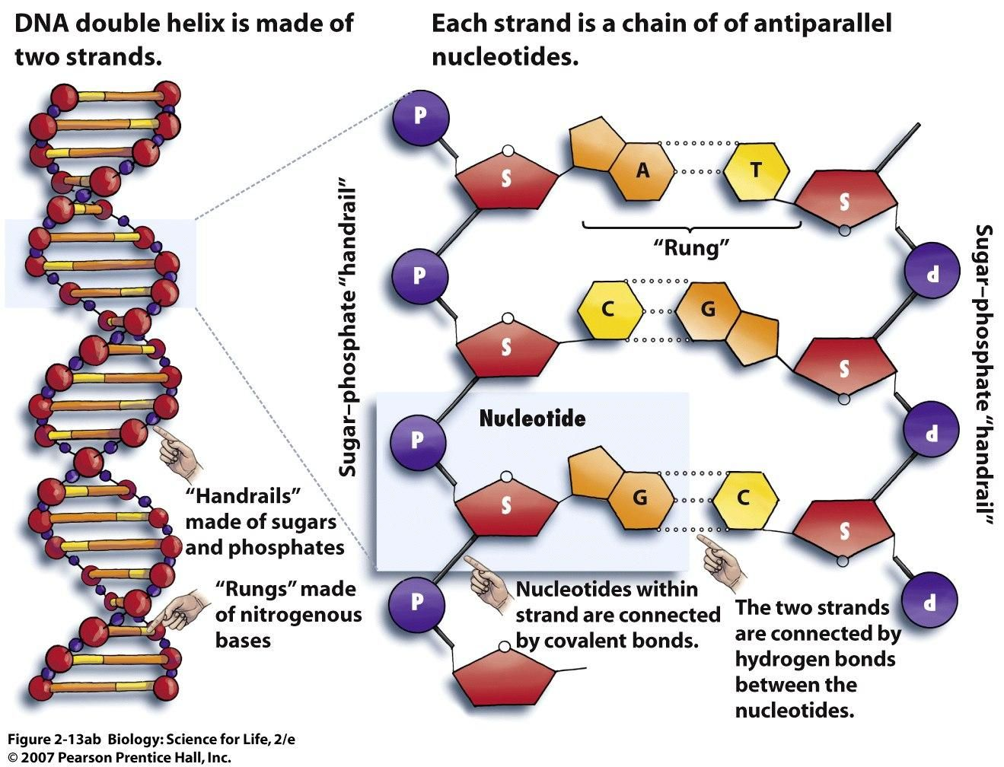
Nucleic Acids

Slide 86
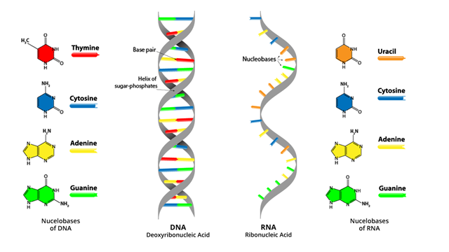
Nucleic Acids
RNA has Ribose as its 5 Carbon sugar. RNA is single stranded. There are several types of RNA. Messenger RNA (mRNA) is made from the DNA template during the process of transcription. mRNA’s job is to transmit the protein building directions from the DNA in the nucleus to the ribosomes in the cytoplasm. Transfer RNA’s (tRNA) job is to deliver and place the appropriate amino acids into the proteins that are built by the ribosomes. Ribosomal RNA (rRNA) is one of the main building components of the cell’s ribosomes.

Slide 87
Nucleic Acids
Scientists can now sequence the nucleotide/nitrogenous bases found in genes of an organism and compare this sequence to the sequence of the same gene found in another organism. The more similar the two sequences are, the more related the two organisms are.

Slide 88
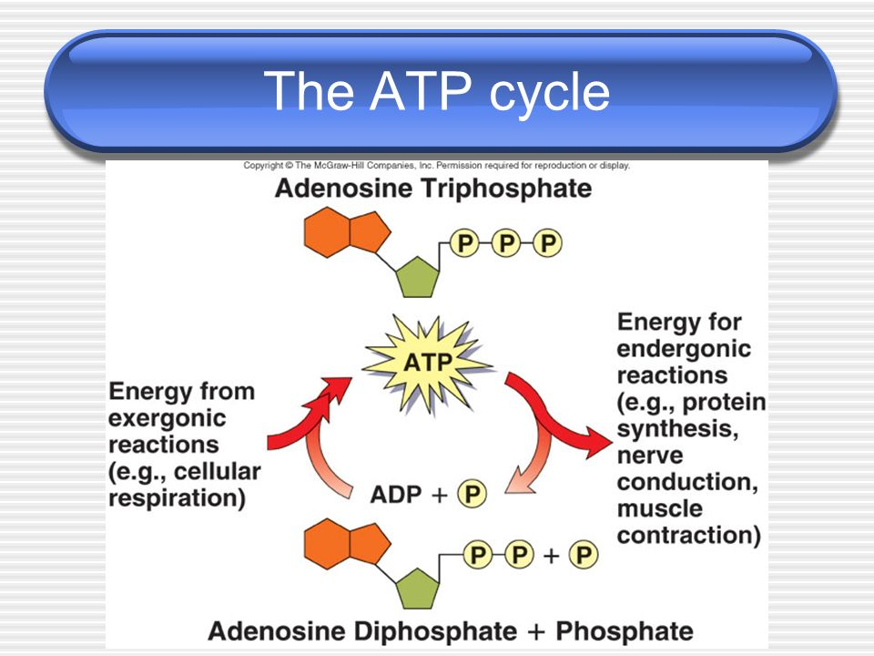
Nucleic Acids
ATP (Adenosine Triphosphate) is another important nucleic acid. An ATP molecule is composed of a single nucleotide which consists of the sugar (ribose) bonded to a nitrogenous base (always adenine), and three phosphate groups. ATP’s role in the body is to store and transfer energy. ATP is made during the process of cellular respiration. It functions to power almost every activity that occurs in the cell. The hydrolysis of ATP is coupled with many of the body’s endergonic reactions and provided the energy needed to power these reactions.

Slide 89
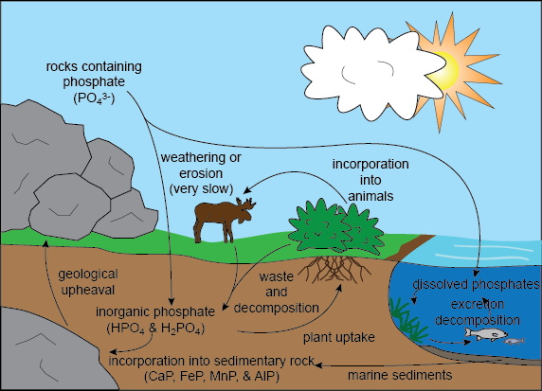
Phosphorus Cycle
The phosphorus cycle is another important biogeochemical cycle. Phosphorus is an important component of DNA, RNA, ATP, phospholipids, and bone. Most of the Earth’s phosphorus is found in rock. As the rock weathers, some of the phosphorus is released into the soil. Some dissolves into the water as the rains pass through the soil. This phosphorus makes its way into bodies of water and is available for producers (phytoplankton) to use to make organic compounds such as phospholipids, DNA, RNA, ATP, etc... Plants can also retrieve the phosphorus directly from the soil and use it to make organic compounds. When organisms die, decomposers break down the bodies and return the phosphorus to the soil so that it can be reused.

