Slide 1
The Legislative Branch
Chapter 5

Slide 2
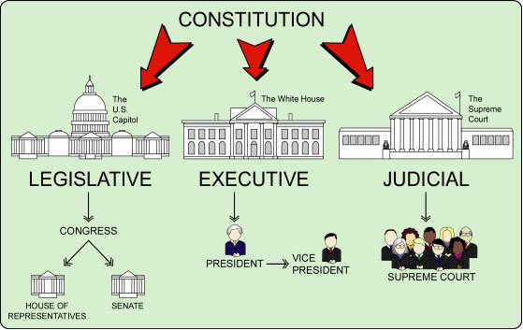
The Houses of Congress
Bicameral legislature
Senate – Every state has 2 representatives
HOR – Based on state population
Each house checks the actions of the other.

Slide 3
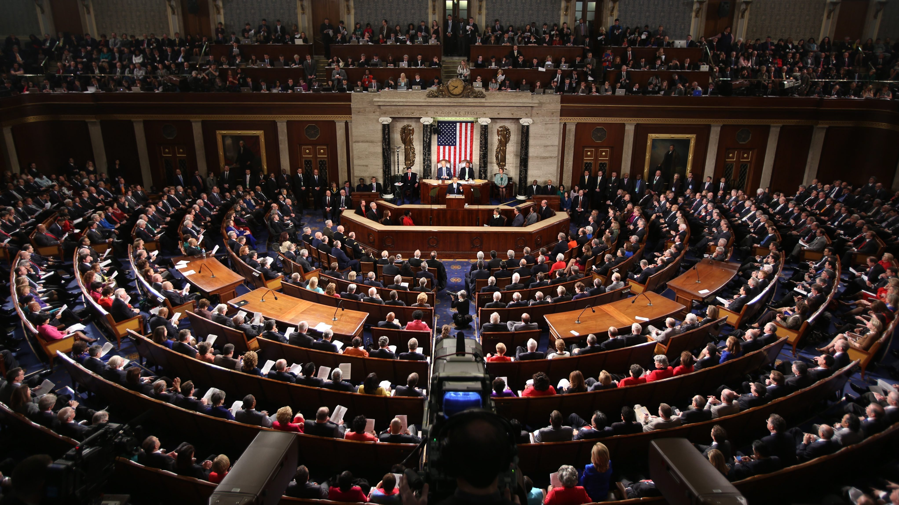
House of Representatives
Number of representatives is based on the state’s population.
435 members in the House
Every ten years after the census seats of the House are apportioned.
Voters elect representatives based on their congressional district.
State legislature is responsible for dividing the state into districts
Gerrymandering is the practice of drawing district lines to favor a party.

Slide 4
Elections for the House of Representatives are held in November of even-numbered years.
Representatives serve two-year terms.
If a Representative dies or resigns before the end of the term the governor calls a special election to fill the vacancy.

Slide 5
The Senate
Every state has two senators regardless of size.
Elections for senators are held in November of even numbered years
Senators hold six-year terms.
Only one-third of the Senate’s membership are up for election every two years.

Slide 6
Members of Congress
Qualifications for Representatives
At least 25
Citizen of the U.S. for seven years
Legal resident of your state
Qualifications for Senators
At least 30
Citizen of the U.S. for nine years
Legal resident of your state

Slide 7
As of January 2006, each member of Congress receives a yearly salary of $165,200 & free travel to their home state
Members have offices in the Capitol building and receive an allowance to pay for staff members
Members of Congress have immunity
Congress can refuse to seat a member
Reviewed by the Supreme Court
Congress has a code of conduct for its members.

Slide 8
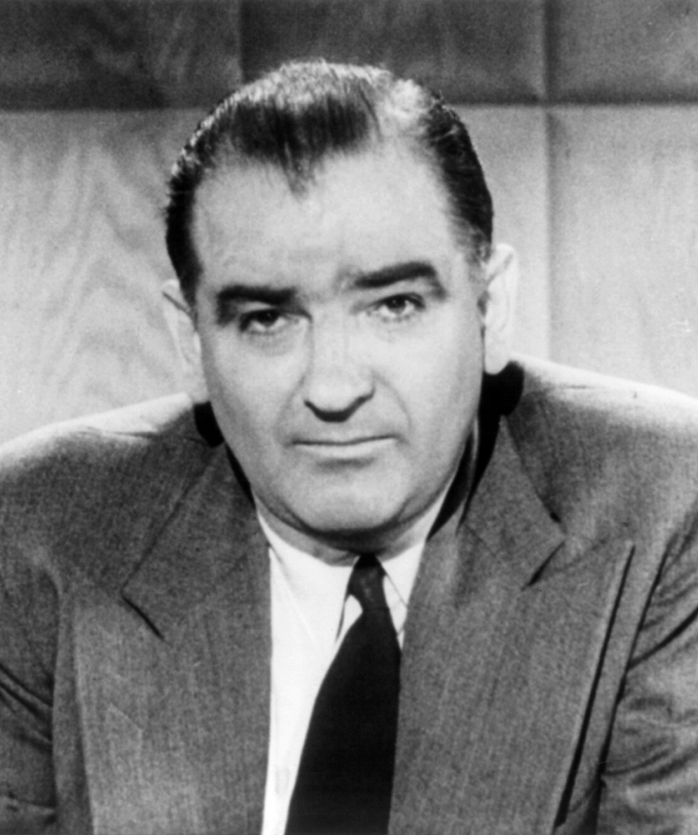
If a member violates the code of conduct…
They can be expelled
Last senator expelled was in 1862 – Jesse D. Bright for supporting the Confederacy
Last representative expelled in 2002
The could be censured
Senate has censured 9 members. Last one in 1990
House has censured 22

Slide 9
Terms and Sessions
The Twentieth Amendment sets Congress’ term to begin at noon on January 3 of every odd-numbered year.
First Congress in 1789
Congress from 2017-2019 is the 115th Congress
Congress must meet at least once each year
Congress is divided into two sessions
Usually begins January 3 and ends when Congress finishes its legislative work
President can call Congress back for a special session

Slide 10
Organization of Congress
Constitution has 3 rules for Congress
The HOR must select a presiding officer
VP of the U.S. is president of the Senate
Selection of a senator to preside in the VP’s absence
After the first day of each term, Republican and Democratic members in each house gather in caucuses.

Slide 11
Majority party is the party with the most members.
The VP doesn’t preside over daily meetings.
Majority party elects president pro tempore
The whip assists the party’s leader by counting votes and ensuring the party’s members are present for a vote.
The Speaker of the House is always a member of the majority party.
Committees and subcommittees view bills before they go to the floor.

Slide 12
Congressional Powers
Article I, Section 8, of the Constitution lists delegated powers of Congress
Financing Gov’t (tax, borrow, print)
Regulating and encouraging American trade and industry
Defending the country
Creating lower courts
Providing for growth (immigration, govern the country’s territories, new states)

Slide 13
Implied Powers
“to make all laws which shall be necessary and proper”
Congress established national military academies
Necessary and proper clause allows Congress to stretch delegated powers
Known as the elastic clause

Slide 14
Congress can impeach federal officials.
Charges are drawn up by the HOR
If majority vote in favor of the charges the official is impeached, or formally accused.
The official will be put on trial by the Senate
The VP usually acts like the judge unless it is the President, then the Supreme Court Justice presides.
Andrew Johnson and Bill Clinton have been impeached but not removed.

Slide 15
Special Powers
HOR must start all bills for raising revenue.
HOR must impeach public officials
HOR selects president if no candidate receives enough electoral votes
Senate holds impeachment trials
Senate selects VP if not enough electoral votes
Senate must approve treaties by two-thirds vote
Senate must approve high officials
The Tenth Amendment reserves powers for the states.

Slide 16
How a Bill Begins
A bill is a proposed law
A bill can be introduced in either house
Appropriation bill must begin in HOR
Both houses must pass the bill
President signs bill after its passed and it becomes a law (AKA: act)
If a large number of constituents requests a law the Congress member usually listens.
In the State of the Union, given at the beginning of a session, the President recommends laws they feel would improve the country.

Slide 17
Bill Consideration
Once a bill is introduced it is given a number
HR1215 or S350
Bills are printed on the Congressional Record after they are introduced.
Bill goes to a permanent congressional committee, standing committee
A bill can be set aside in committee and never return to the floor
Committee calls witnesses to testify for and against the bill
The committee can pass the bill without changes, make changes and pass the bill, or vote to kill the bill.

Slide 19
Bills in the House
In the HOR, if the committee recommends a bill it is put on the agenda.
The Speaker decides what order the bill are heard.
The House debates the bill
The House Rules Committee decides how much time will be given to debate a bill
A quorum, or majority of the members, must be present to vote on a bill
Majority needed to pass a bill
Roll call vote is taken

Slide 20
Bills in the Senate
Bills are read and sent to committee
After committee hearings the bill is sent back to the Senate for a vote
Senators are not limited in their debate of a bill
Some senators may use a filibuster, or “talk the bill to death,” to prevent a vote
Cloture, or ending a debate in the Senate, takes a three-fifths of the full Senate.
Once the bill passes the House and Senate in identical form it goes to the President.

Slide 21
Bills and the President
President can take 3 possible actions
Sign the bill and it goes into law
Veto - Refuse to sign the bill and it is sent back to Congress to revise
Pocket veto – keep the bill for 10 days without signing or vetoing. If Congress is in session it becomes a law. If Congress is not in session the bill is killed (not used often)
Congress can pass a bill over Presidential veto but need a two-thirds vote in both houses

