Slide 1
Executive Branch

Slide 2
The Presidency
Requirements to be President
Native-born U.S. citizen
At least 35 years of age; and
Have been a resident of the U.S. for at least 14 years.
Elected to a four year term
George Washington set the precedent of a two-term limit
1951 – Twenty-second Amendment set the two-term limit
Paid $400,000 a year, plus $50,000 allowance, and allowance for travel

Slide 3
Vice Presidency
VP serves as president if the president dies, leaves office, or is unable to fulfill his duties.
$208,100/year salary.
VP presides over the Senate
Job outlined in the Constitution
Presidents often give their VP more jobs

Slide 4
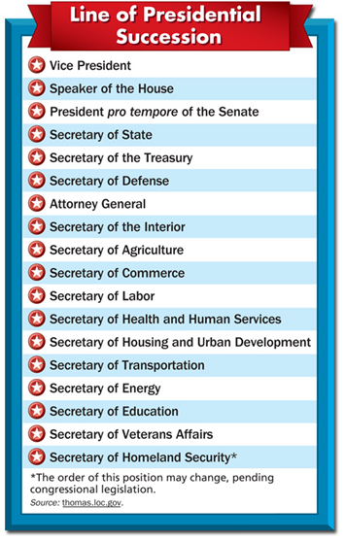
Presidential Succession
The Twenty-fifth Amendment provides that the new president nominates a new VP
The Twentieth Amendment gives Congress the power to set the presidential succession.
Speaker of the House is after VP
Followed by president pro tempore in the Senate

Slide 5
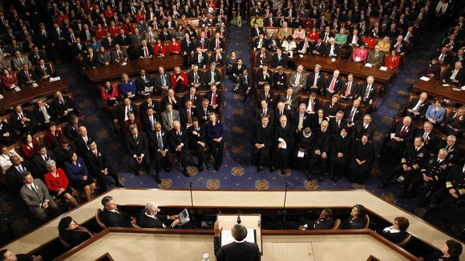
The President’s Roles
The president recommends new laws to Congress in the State of the Union Address
Usually given in late January
Programs and policies usually address the country’s most pressing concerns
President can also veto bills of programs he does not want to address

Slide 6
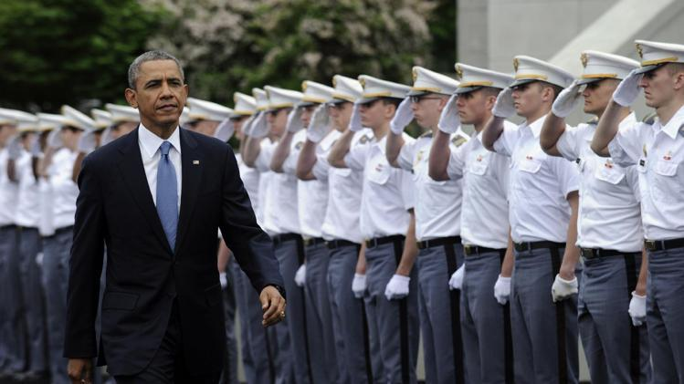
President is the commander in chief of the U.S. armed forces
President stays in constant contact with military leaders.
Only Congress can declare war but the President can send troops anywhere U.S. interest are threatened.
War Powers Resolution (1973) says that troops must be recalled within 60 days.

Slide 7
The president must also pay attention to foreign policy
President appoints diplomats to represent the U.S. gov’t in other countries.
The president meets with foreign leaders, known as diplomacy.
President assumes final responsibility for treaties.
Senate must approve treaty by two-thirds vote.

Slide 8
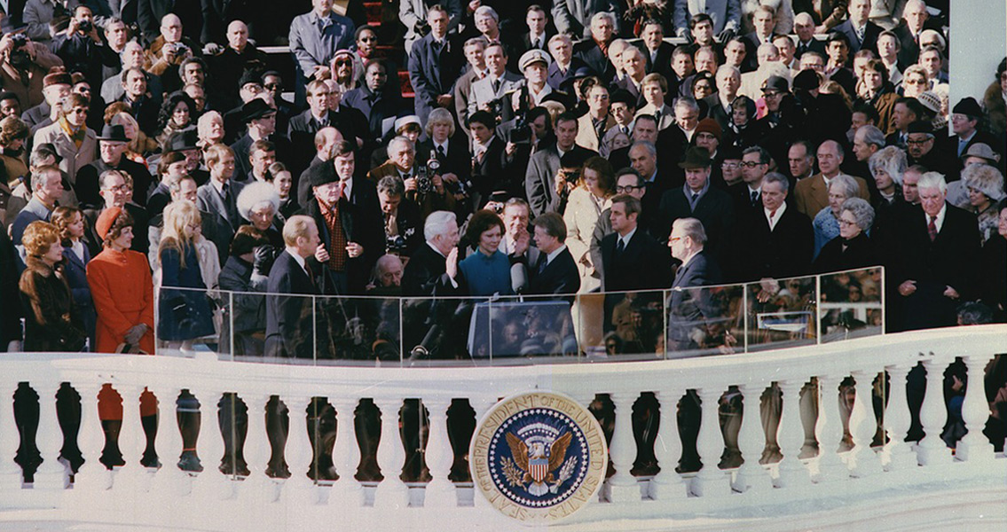
President appoints Supreme Court justices.
Senate must approve justices
Can grant a reprieve
Postponing a person’s sentence
A pardon forgives a person of their crime
A commutation reduces a person’s sentence.

Slide 9
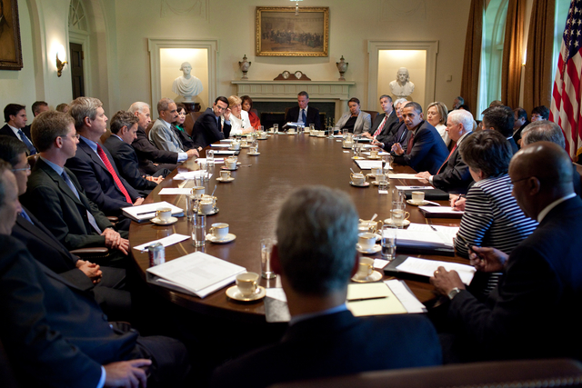
The Executive Office and the Cabinet
The White House Office includes the president’s closest personal and political advisers
The executive branch under Washington had 5 departments and the heads of those departments were his cabinet.
Today, there are 15 departments.
President appoints members to his cabinet and Senate must approve these appointments

Slide 10
The title of most cabinet members is secretary.
The head of the Department of Justice is known as the attorney general.

Slide 11
Department of State
Foreign policy is the responsibility of the Department of State
Secretary of state heads the officials who represent the U.S. around the world.
Ambassadors are the highest-ranking U.S. representatives in foreign countries.
The embassy is the official residence and office of an ambassador.

Slide 12
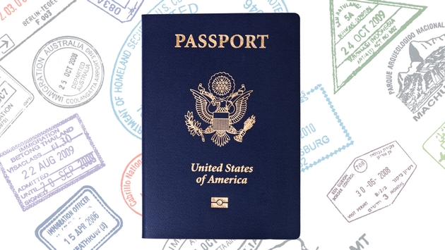
A consul represents the U.S. commercial issue.
Consulate can be found in most large foreign cities
At home the Department of State keeps track of people’s travel.
Passports allow US citizens to travel abroad
Visas allow foreigners to come to the US

Slide 13
Department of Defense
In charge of the armed forces and operates military bases
Secretary of defense is always a civilian
Ensures nonmilitary control over the armed forces
Joint Chiefs of Staff are the highest-ranking military officers for each armed force
Advise the president on military affairs

Slide 14
Other Executive Departments
Congress creates new departments.
Department of Homeland Security was created after 9/11 to prevent terrorist attacks
Department of Justice enforces laws of the US.
Treasury Department promotes economic prosperity.

