Slide 1
Judicial Branch

Slide 2
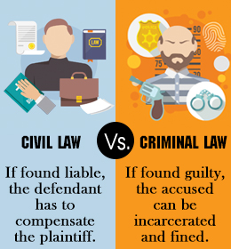
A Nation of Laws
Two categories of laws
Criminal – conduct of people
Civil – disputes between people
Criminal laws protect society as a whole.
Civil law is if you cannot settle a dispute with someone privately.

Slide 3
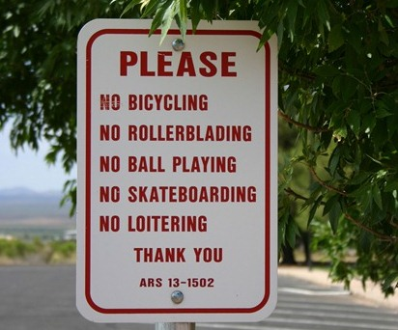
Sources of Law
4 Sources of law
Statutory, common, administrative, and constitutional
Statutory Law
Laws passed by lawmaking bodies are statutes
Represents majority rule – what majority of citizens believe to be right or wrong
The law can adapt to the country’s needs.

Slide 4
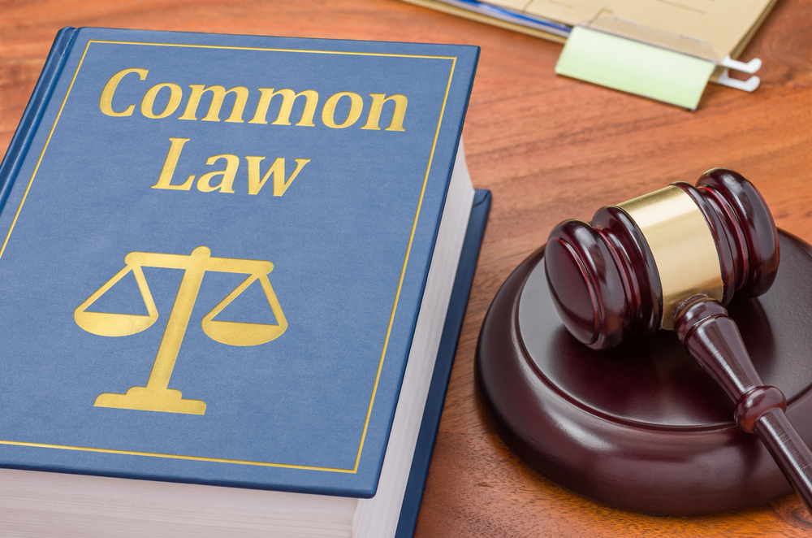
Common Law
Judges decisions that rely on common sense and previous cases.
Judges might follow the same precedent when considering cases
Administrative Law
Created by govt agencies
Covers health, safety, education, & banking

Slide 5
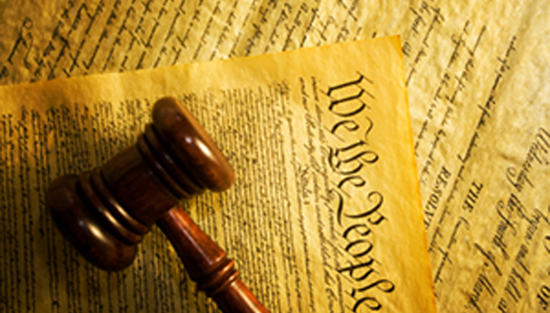
Constitutional Law
Constitution is the supreme law of the land.
This type of law is based on the Constitution and the Supreme Court’s decisions interpreting the Constitution

Slide 6
Roles of the Courts
Courts use the four sources of laws to settle disputes.
In criminal cases the dispute is against society and people
In civil cases the dispute is between 2 people.
In criminal cases the person accused is innocent until proven guilty.
Also, they have the right to an attorney, the right to confront the accuser, and the right to a jury trial.

Slide 7
If the person is convicted of a crime, they can appeal the decision.
A review of a decision helps to ensure that cases are decided fairly.

Slide 8
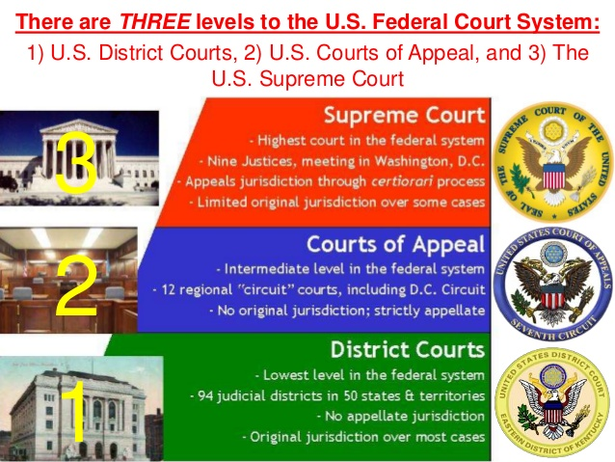
U.S. District Courts
Article III sets up the court system
3 levels of federal courts (district, appeals, Supreme)
Each court has a different jurisdiction
Two types of jurisdictions
Original and appellate

Slide 9
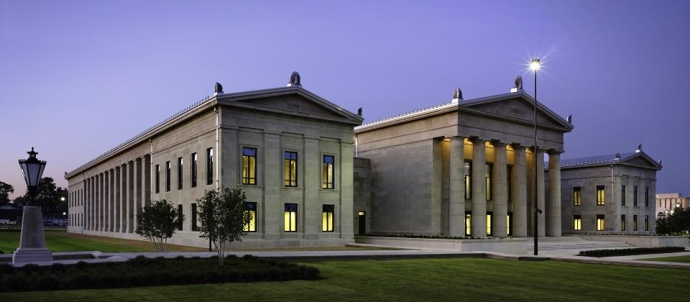
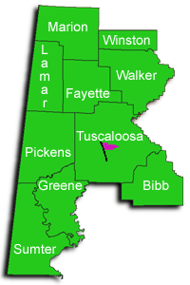
District courts are the lowest level
They have original jurisdiction
The only federal court in which jury trials are held.
There is at least one district court in each state.
94 total district courts.

Slide 10
Federal district judges are trial judges
Can conduct both civil and criminal cases with or without a jury.
Appointed for life (except for judges in territories) by the President and approved by the Senate.
Federal judges can be impeached.

Slide 11
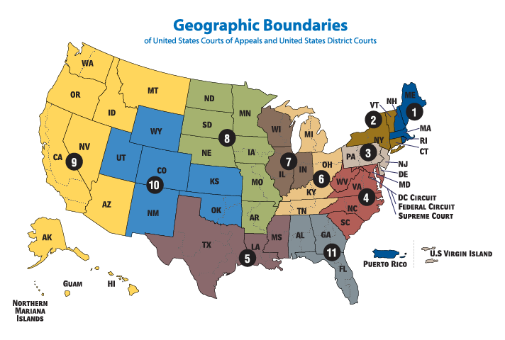
U.S. Courts of Appeals
After losing in district court, the party can appeal to the next level.
Courts of appeals have appellate jurisdiction.
There are 12 judicial circuits and each circuit has its own court of appeals.
AL is in the 11th circuit

Slide 12
6-28 judges in each court of appeals
Court of appeals do not hold trials
Panel of at least 3 judges decides on the case.
Do not decide whether the person is guilty or innocent.
Determine if the original trial was fair and if the law was interpreted correctly.
Judges reach their decision by a majority vote
Usually the final decision, however, cases can be appealed to the Supreme Court

Slide 13
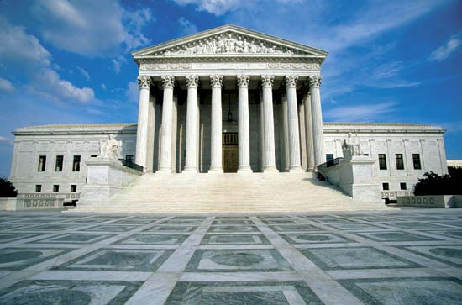
U.S. Supreme Court
Highest court in the land is the Supreme Court.
There are nine justices
Supreme Court decision cannot be appealed
Has original jurisdiction in 3 types of cases
Tries cases involving diplomatic representatives of other countries, cases between the states, cases involving a state and the federal govt.

Slide 14
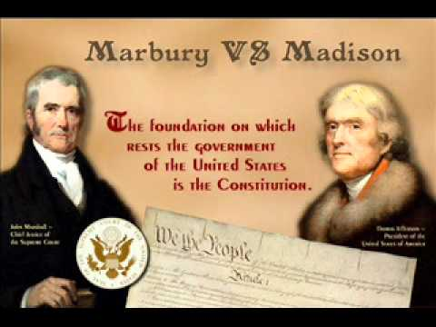
The Power of Judicial Review
Judicial review allows courts to decide if a law is in agreement with the Constitution.
John Marshall established judicial review when he served as Supreme Court Justice from 1801-1835
Not given in the Constitution
Marbury v. Madison was the first case to used judicial review in 1803

Slide 15
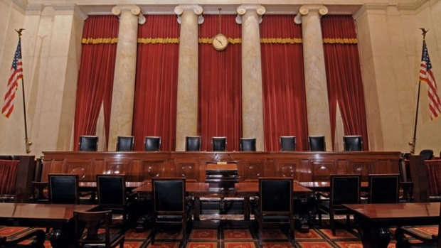
Supreme Court Cases
More than 7,000 cases are filed with the Supreme Court each year.
Only hear 130-150
Court may remand a case to a lower court for a new trial
Supreme Court hears oral arguments.
Each lawyer has 30 minutes to present their case.
Justices then read written arguments and consider what the court said.

Slide 16
Justices hold a private meeting to vote.
Decisions are reached by a simple majority.
Court delivers its opinion.
Explains reasoning behind decision.
Concurring opinions are if they agree with the decision but for different reasons
Dissenting opinions are for if they do not agree.
Congress decides the size of the Supreme Court
Set at 9 since 1869
Justices can be removed only by impeachment.

Slide 17
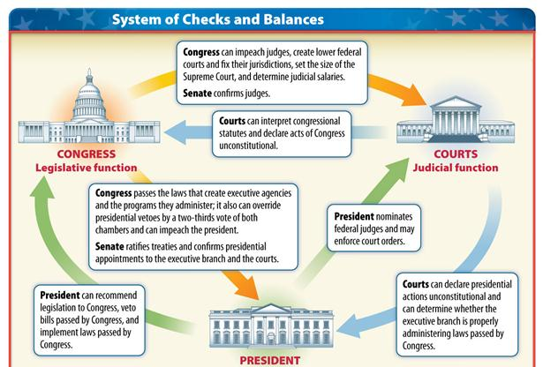
Checking the Courts Power
The executive branch appoints federal judges
Senate approves appointments.
Congress can rewrite laws that the Supreme Court finds unconstitutional.
Congress can amend the Constitution

